Slide 1
2023 NFHS football rules powerpoint
Notes:
This PowerPoint presentation from the National Federation of State High School Associations (NFHS) covers the following:
2023 NFHS Football Rules Changes-
2023 NFHS Football Editorial Changes-
2023 NFHS Football Points of Emphasis-
2023 NFHS Football Rules Reminders-
2023-24 NFHS Football Information-

Slide 2
National federation of state high school associations (NFHS)

Slide 3
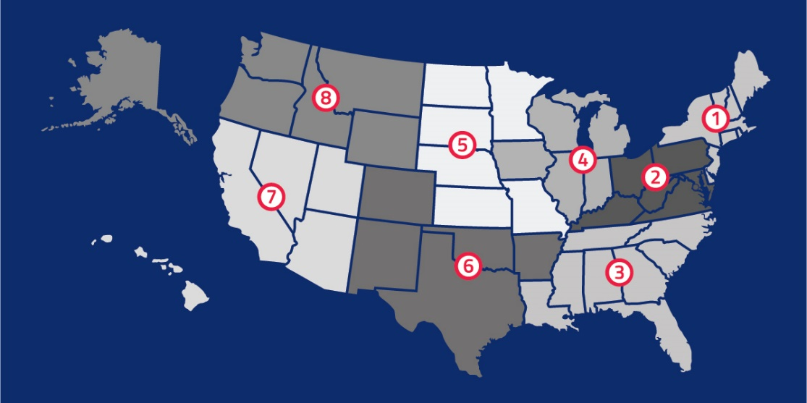
National Federation of
State High School Associations
NFHS (located in Indianapolis, IN – Est. 1920):
  National leader and advocate for
  high school athletics and
  performing arts programs.
  Serves 51 state associations, 19,500
  high schools and 12 million student
  participants.
  Writes playing rules for 17 high school
  sports for boys and girls.
  Offers online education courses for high school coaches,
  officials, parents, students and others.
  Ensures that students have opportunity to enjoy healthy participation, achievement and good sportsmanship in education-based athletics.
Notes:
Comment on Slide:
Overview of the NFHS.

Slide 4








NFHS Rules Review Committee
The NFHS Rules Review Committee is chaired by the chief operating officer and composed of all rules editors. After each committee concludes its deliberations and has adopted its recommended changes for the subsequent year, such revisions will be evaluated by the Rules Review Committee.
Davis Whitfield
Chief Operating Officer
Lindsey Atkinson
Basketball, Girls Lacrosse and Volleyball
Bob Colgate
Football and Sports
Medicine
Sandy Searcy
Softball, Swimming & Diving and Water Polo
Elliot Hopkins
Baseball and Wrestling
Julie Cochran
Cross Country, Gymnastics, Field Hockey, Soccer and
Track & Field
James Weaver
Boys Lacrosse
and Spirit
Dan Schuster
Ice Hockey
Notes:
Comment on Slide:
Overview of NFHS Rules Review Committee.

Slide 5
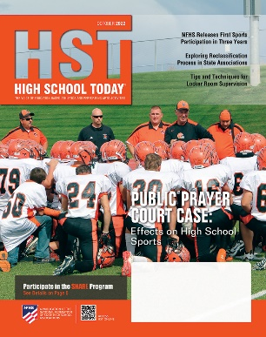


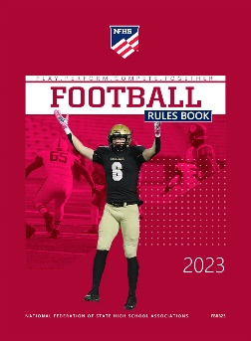
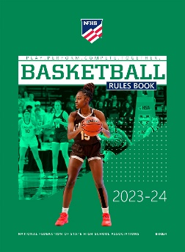

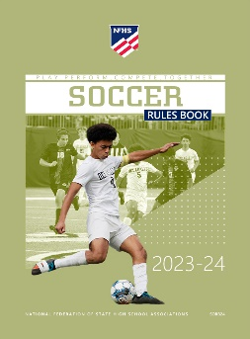





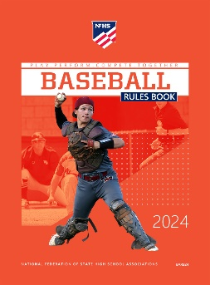
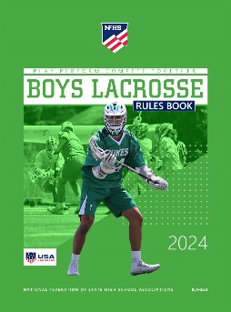

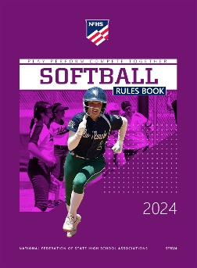

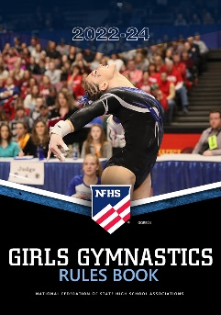
National Federation of
State High School Associations
The NFHS writes playing rules for 17 sports
for boys and girls at the high school level.
  Publishes 4 million pieces of materials annually.
Notes:
Comment on Slide:
Overview of NFHS Rules Books and Publications.

Slide 6
2023 nfhs football rules changes

Slide 7
Nfhs football rules
Each state high school association adopting these NFHS football rules is the sole and exclusive source of binding rules interpretations for contests involving its member schools. Any person having questions about the interpretation of NFHS football rules should contact the football rules interpreter designated by the respective state high school association.
The NFHS is the sole and exclusive source of model interpretations of NFHS football rules. State rules interpreters may contact the NFHS for model football rules interpretations. No other model football rules interpretations should be considered.
Notes:
Comment on Slide:
This statement appears at the bottom of page three in the 2023 NFHS Football Rules Book.

Slide 8

Rule 1-5-3a(5)a 4, 5 (NEW)
UNIFORM ADORNMENTS - TOWELS
It is legal for a player to have one moisture-absorbing solid-colored towel that has no more than one visible manufacturer's logo/trademark reference that does not exceed 2¼ square inches and does not exceed 2¼ inches in any dimension; and has no more than one school logo/trademark reference that does not exceed 2¼ square inches and does not exceed 2¼ inches in any dimension.
Towels do not have to be the same solid color for each player.
Notes:
Rule Change:
RULE 1 – SECTION 5 PLAYER EQUIPMENT
ART. 3 . . . Illegal equipment. No player shall participate while wearing illegal equipment. This applies to any equipment, which in the opinion of the umpire is dangerous, confusing or inappropriate. Illegal equipment shall always include but is not limited to:
a. The following items related to the Game Uniform: …
5. Uniform adornments, with the exception of:
(a) One moisture-absorbing solid-colored towel that:
(1) is not ball- or penalty flag-colored;
(2) is no less than 4 inches in width and 12 inches in length;
(3) is no greater than 18 inches in width and 36 inches in length;
(4) has no more than one visible manufacturer's logo/trademark reference that does not exceed 2¼ square inches and does not exceed 2¼ inches in any dimension; and
(5) has no more than one school logo/trademark reference that does not exceed 2¼ square inches and does not exceed 2¼ inches in any dimension. …
Rationale for Change:
Player towels may contain one manufacturer’s logo and/or one school logo neither exceeding 2¼ square inches. Towels must be a solid color but now do not have to be the same solid color for each player. Towels may not be ball- or penalty-flag colored.
Case Book: See SITUATION 3.5.10L

Slide 9
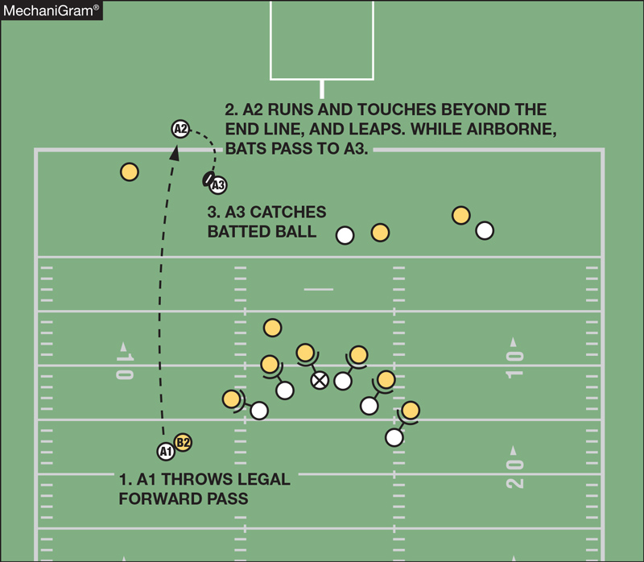
Rule 2-29-1 player out OF BOUNDS
A2 is out of bounds as he has not had any body part touch inbounds. Therefore, when A2 intentionally touches the ball after being out of bounds, he has caused the ball to become dead. The pass is incomplete and A2 is guilty of illegal participation.
Notes:
Rule Change:
RULE 2 – SECTION 29 OUT OF BOUNDS
ART. 1 . . . A player or other person is out of bounds when any part of the person is touching anything, other than another player or game official that is on or outside the sideline or end line, and that player remains out of bounds until returning to the field with any body part touching the field and no body part touching out of bounds.
Rationale for Change:
This change clarifies when a player is inbounds after being out of bounds. There is no change to any foul or subsequent penalty provisions, or any rules related to illegal participation or the provisions regarding eligibility to catch a pass.
Case Book: See SITUATIONS 7.5.4C, 9.6.2A, 9.6.2B, 9.6.2C

Slide 10
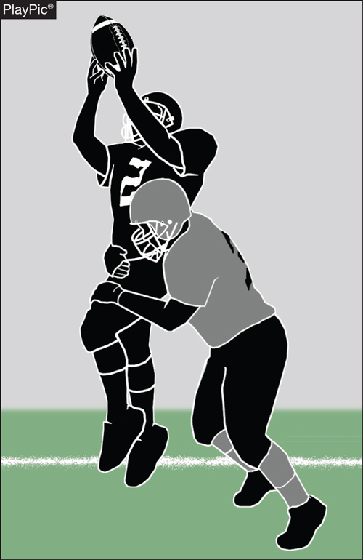
Rule 2-32-16d (NEW), 9-4-3g
DEFENSELESS RECEIVERS
The receiver is not defenseless because the opponent is attempting to tackle by wrapping arm(s) around the receiver.
Notes:
Rule Change:
RULE 2 – SECTION 32 PLAYER DESIGNATIONS
ART. 16 . . . A defenseless player is a player who, because of his physical position and focus of concentration, is especially vulnerable to injury. A player who initiates contact against a defenseless player is responsible for making legal contact. When in question, a player is defenseless. Examples of defenseless players include, but are not limited to:
a. A passer;
b. A receiver attempting to catch a pass who has not had time to clearly become a runner;
c. The intended receiver of a pass in the action during and immediately following an interception or potential interception;
d. A receiver in (b) and (c) above, including the person intercepting the pass, who is forcefully contacted by an opponent and that contact is not:
1. Incidental contact as a result of making a play on the ball;
2. Initiated with open hands; or
3. An attempt to tackle by wrapping arm(s) around the receiver.
e. A runner already in the grasp of a tackler and whose forward progress has been stopped;
f. A kickoff or punt returner attempting to catch or recover a kick, or one who has completed a catch or recovery and has not had time to protect himself or has not clearly become a runner;
g. A player on the ground including a runner who has obviously given himself up and is sliding feet-first;
h. A player obviously out of the play or not in the immediate vicinity of the runner; and
i. A player who receives a blindside block with forceful contact not initiated with open hands.
RULE 9 – SECTION 4 ILLEGAL PERSONAL CONTACT
ART. 3 . . . No player or nonplayer shall: …
g. Make any other contact with an opponent, including a defenseless player (as in 2-32-16), which is deemed unnecessary or excessive and which incites roughness. …
Rationale for Change:
This change adds to the list of criteria to help identify players who should be defined as defenseless receivers related to application of unnecessary or excessive contact. This clarification should help game officials and coaches by defining allowable contact against defenseless receivers.
Case Book: See SITUATIONS 2.32.16 COMMENT, 9.4.3 COMMENT

Slide 11

Rule 2-32-16d (NEW), 9-4-3g
DEFENSELESS RECEIVERS
The receiver is not defenseless even if the contact by the opponent is forceful because the contact is initiated with open hands. The contact could be pass interference, however.
Notes:
Comment on Slide:
See comments on slide.

Slide 12
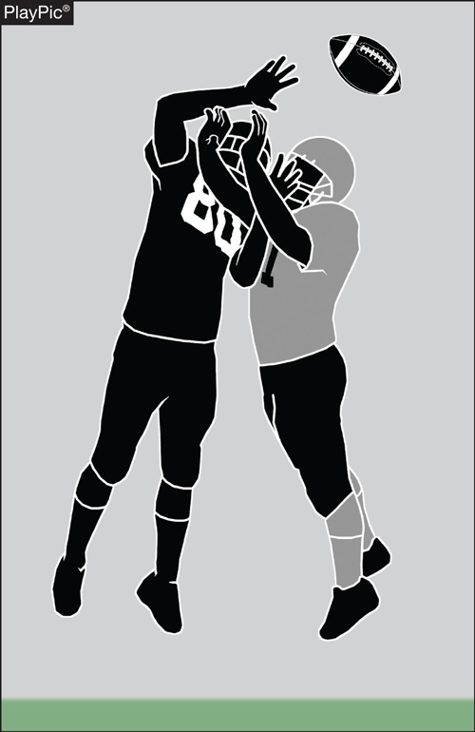
Rule 2-32-16d (NEW), 9-4-3g
DEFENSELESS RECEIVERS
The receiver is not defenseless because of the incidental contact as a result of the defender making a play on the ball.
Notes:
Comment on Slide:
See comments on slide.

Slide 13
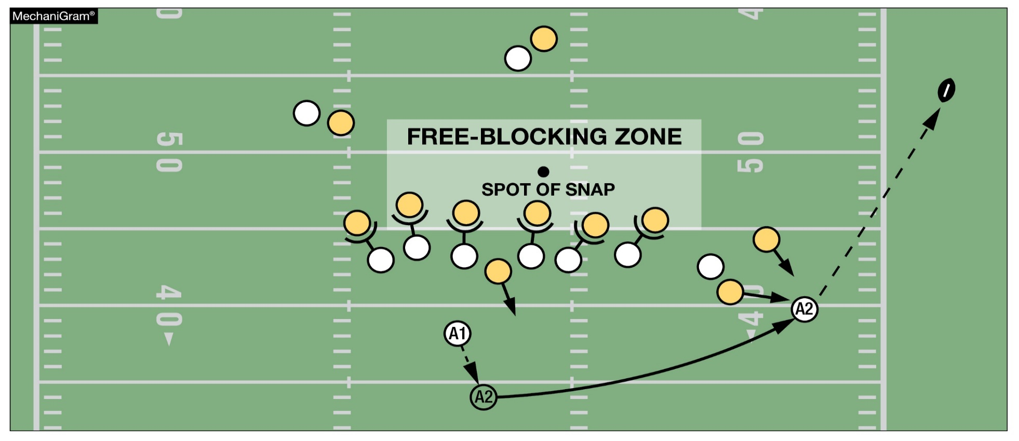
Rule 7-5-2d EXCEPTION 2a, c (NEW), TABLE 7-5-2 d EXCEPTION 2a, c (NEW), TABLE 7-5 (1) d EXCEPTION 2a, c (NEW) intentional grounding EXCEPTION
This is a foul for intentional grounding since A2 is the second player to possess the ball. Only the player who possessed the ball after the snap ends may take advantage of the intentional grounding exception.
Notes:
Rule Change:
RULE 7 – SECTION 5 FORWARD-PASS CLASSIFICATION
ART. 2 . . . An illegal forward pass is a foul. Illegal forward passes include:
a. A pass after team possession has changed during the down.
b. A pass from beyond the neutral zone.
c. A second and subsequent forward pass(es) thrown during a down.
d. A pass intentionally thrown into an area not occupied by an eligible offensive receiver, or thrown incomplete to save loss of yardage or to conserve time.
EXCEPTIONS:
1. It is legal for a player positioned directly behind the snapper to conserve time by intentionally throwing the ball forward to the ground immediately after receiving the snap that has neither been muffed nor touched the ground.
2. It is legal for a player to conserve yardage by intentionally throwing an incomplete forward pass if all of the following conditions are met:
a. The passer has possessed the ball beyond the lateral boundary of the free-blocking zone as established at the snap;
b. The pass reaches the neutral zone, including the extension beyond the sideline; and
c. The passer is the only player to possess the ball after the snap ends.
Rationale for Change:
This change permits the exception for intentional grounding to the first and only player to possess the
ball after the snap ends.
Case Book: See SITUATION 7.5.2D

Slide 14
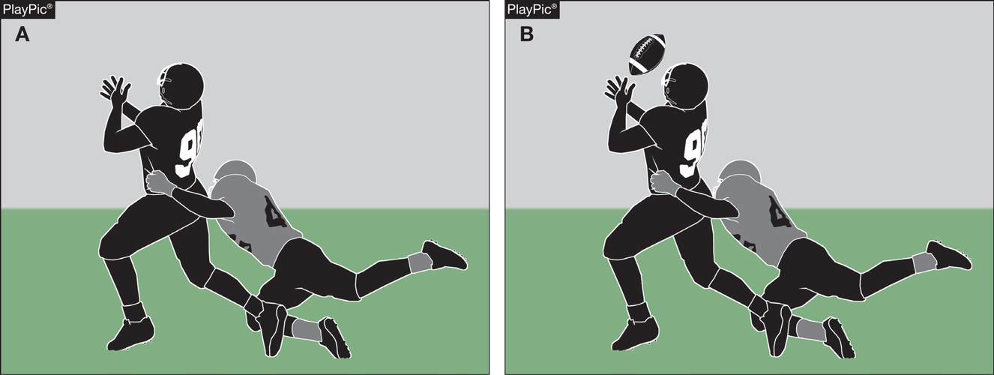
TABLE 7-5 2c (DELETED), 7-5 PENALTY intentional pass interference
The additional penalty for intentional pass interference as illustrated in PlayPic A has been deleted. The Team B player in the gray jersey will be penalized 15 yards for the pass interference foul committed in PlayPic B.
Notes:
Rule Change:
RULE 7 – SECTION 5 FORWARD-PASS CLASSIFICATION
TABLE 7-5 – SUMMARY OF FOULS THAT CAN OCCUR DURING FORWARD PASS PLAYS AND THEIR PENALTIES AND ENFORCEMENT SPOTS …
2. Forward Pass Interference (7-5-10)
Restrictions apply only to a legal pass, untouched by B in or behind the neutral zone which crosses the neutral zone and interference may occur only beyond the neutral zone.
a. A hinders B. (Restriction begins with the snap.)
b. B hinders A. (Restriction begins when the pass is thrown.)
Rationale for Change:
By removing “intentional” from pass interference, this change puts the rule in line with how it is already enforced which is a 15-yard penalty.

Slide 15
Rule 10-4, Table 10-4 (NEW), 10-6 (DELETED) basic spot
summary of many fouls that can occur during running plays and their penalties and basic spots unless otherwise specified by rule
FOUL BY | SPOT OF FOUL | END OF PLAY | BASIC SPOT | REFERENCE
A | Behind Line of Scrimmage | Behind Line of Scrimmage | Previous Spot | 10-4-2d
A | Behind Line of Scrimmage | Beyond Line of Scrimmage | Previous Spot | 10-4-2e
A | Beyond Line of Scrimmage | Behind Line of Scrimmage | Previous Spot | 10-4-2f
A | Beyond Line of Scrimmage | Beyond Line of Scrimmage | Foul Behind End of Run or Related Run – Spot of Foul | 10-4-4d
A | Beyond Line of Scrimmage | Beyond Line of Scrimmage | Foul Advance of End of Run or Related Run – Succeeding Spot | 10-4-5e
B | Behind Line of Scrimmage | Behind Line of Scrimmage | Previous Spot | 10-4-2d
B | Behind Line of Scrimmage | Beyond Line of Scrimmage | Succeeding Spot | 10-4-5f
B | Beyond Line of Scrimmage | Behind Line of Scrimmage | Previous Spot | 10-4-2d
B | Beyond Line of Scrimmage | Beyond Line of Scrimmage | Succeeding Spot | 10-4-5f
NOTE: The basic spot is the spot of the foul when A commits any foul in his end zone for which the penalty is accepted (8-5-2c).
Notes:
Rule Change:
RULE 10 – SECTION 4 BASIC SPOTS
TABLE 10-4 - SUMMARY OF MANY FOULS THAT CAN OCCUR DURING RUNNING PLAYS AND THEIR PENALTIES AND BASIC SPOTS UNLESS OTHERWISE SPECIFIED BY RULE
Enforcement provisions apply to all player fouls, and the committee philosophy is based on the fact that a team is given the advantage of the distance which is gained without the assistance of a foul. All fouls are penalized from the basic spot unless the spot is otherwise specified by rule.
The type of play has significance if a foul occurs. If a foul does occur, the game officials must know the type of play as defined in 2-33, as this will aid in determining the basic spot of enforcement when the spot is otherwise specified by rule. Recent changes to 10-4 specify the data needed by the game official regarding the spot of the foul and the result of the play to help guide penalty enforcement.
Rationale for Change:
This change restructures and clarifies the amendments to Rule 10 to eliminate the excessive penalty enforcements for offensive fouls that occur behind the line of scrimmage. This revision stipulates the basic spot for enforcement of fouls behind the line of scrimmage is the previous spot rather than the spot of the foul unless otherwise specified by rule. Current penalties for illegal kicking, batting and participation fouls, and provisions for offensive fouls occurring in the end zone that may result in a safety remain intact.

Slide 16
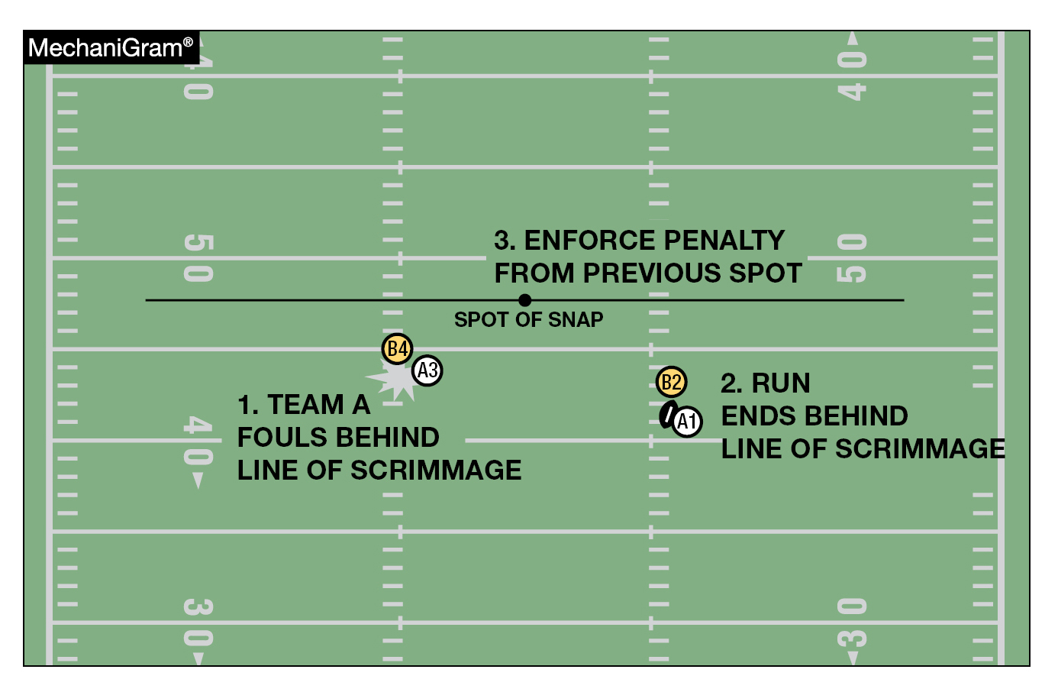
Rule 10-4-2d basic spot for running play penalty enforcement
The basic spot is the previous spot for a foul by A when the run or related run ends behind the line of scrimmage where there is no change of possession.
Notes:
Rule Change:
RULE 10 – SECTION 4 BASIC SPOTS
ART. 1 . . . If a foul occurs during a down, the basic spot is determined by the action that occurs during the down. This is the basic spot for penalty enforcement.
ART. 2 . . . The basic spot is the previous spot unless 8-5-2c applies for:
a. A foul which occurs simultaneously with the snap or free kick.
b. A foul which occurs during a loose ball play, as defined in 10-3-1. See 10-5-5 for special enforcement on roughing the passer. See 10-5-1b for special enforcement on kick-catching interference.
c. A foul which occurs during a down in which a legal kick occurs and an inadvertent whistle ends the down prior to possession by either team.
d. A foul by A or B when the run or related run ends behind the line of scrimmage where there is no change of possession;
e. A foul by A that occurs behind the line of scrimmage when the run or related run ends beyond the line of scrimmage;
f. A foul by A that occurs beyond the line of scrimmage when the run or related run ends behind the line of scrimmage; and
g. A foul by A or B when the run or related run ends behind the line of scrimmage before a change of possession. …
ART. 4 . . . The basic spot is the spot of the foul for:
a. Illegal batting or illegal kicking when the foul occurs behind the end of therun or related run;
b. Illegal participation as in 9-6-4a and 9-6-4g;
c. An illegal forward pass as in 7-5-2c and intentional grounding as in 7-5-2d;
d. A foul by the team in possession that occurs behind the end of the run orrelated run following a change of possession;
e. When A commits any foul in his end zone for which the penalty is accepted(8-5-2c); and
f. A foul by A that occurs beyond the line of scrimmage during a running playas defined in 10-3-2 when:
1. The run or related run ends beyond the line of scrimmage; and
2. The foul occurs behind the end of the run or related run.
ART. 5 . . . The basic spot is the succeeding spot for:
a. An unsportsmanlike foul.
b. A dead-ball foul.
c. A nonplayer foul.
d. When the final result is a touchback.
e. A foul by B when the run or related run ends beyond the line of scrimmage;
f. A foul that occurs beyond the end of the run or related run following a change of possession; and
g. A foul by A that occurs beyond the line of scrimmage during a running play as defined in 10-3-2 when:
1. The run or related run ends beyond the line of scrimmage; and
2. The foul occurs in advance of the end of the run or related run.
NOTE: The succeeding spot may, at the option of the offended team, be the subsequent kickoff as in 8-2-2, 8-2-3, 8-2-4 and 8-2-5. …
ART. 8 . . . The basic spot is the spot where the related run ends for a foul which occurs during a running play as defined in 10-3-2 unless the provisions of 10-4-2 through 10-4-7, or 10-5 apply.
Rationale for Change:
This change restructures and clarifies the amendments to Rule 10 to eliminate the excessive penalty enforcements for offensive fouls that occur behind the line of scrimmage. This revision stipulates the basic spot for enforcement of fouls behind the line of scrimmage is the previous spot rather than the spot of the foul unless otherwise specified by rule. Current penalties for illegal kicking, batting and participation fouls, and provisions for offensive fouls occurring in the end zone that may result in a safety remain intact.

Slide 17
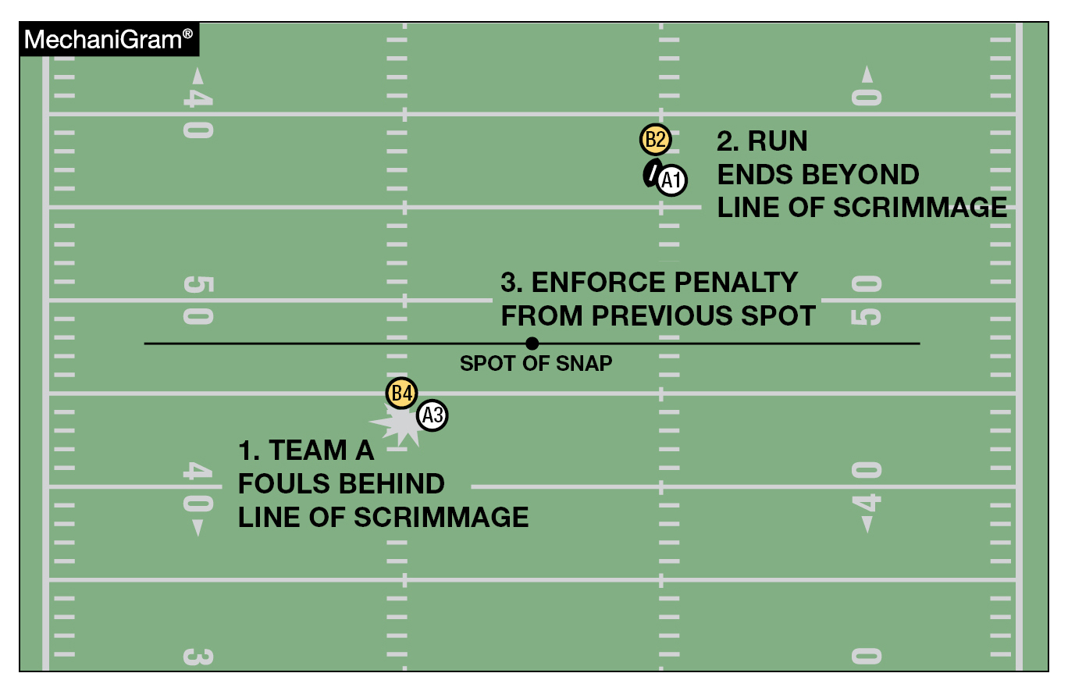
Rule 10-4-2e basic spot for running play penalty enforcement
The basic spot is the previous spot for a foul by A that occurs behind the line of scrimmage when the run or related run ends beyond the line of scrimmage.
Notes:
Comment on Slide:
See comments on slide.

Slide 18
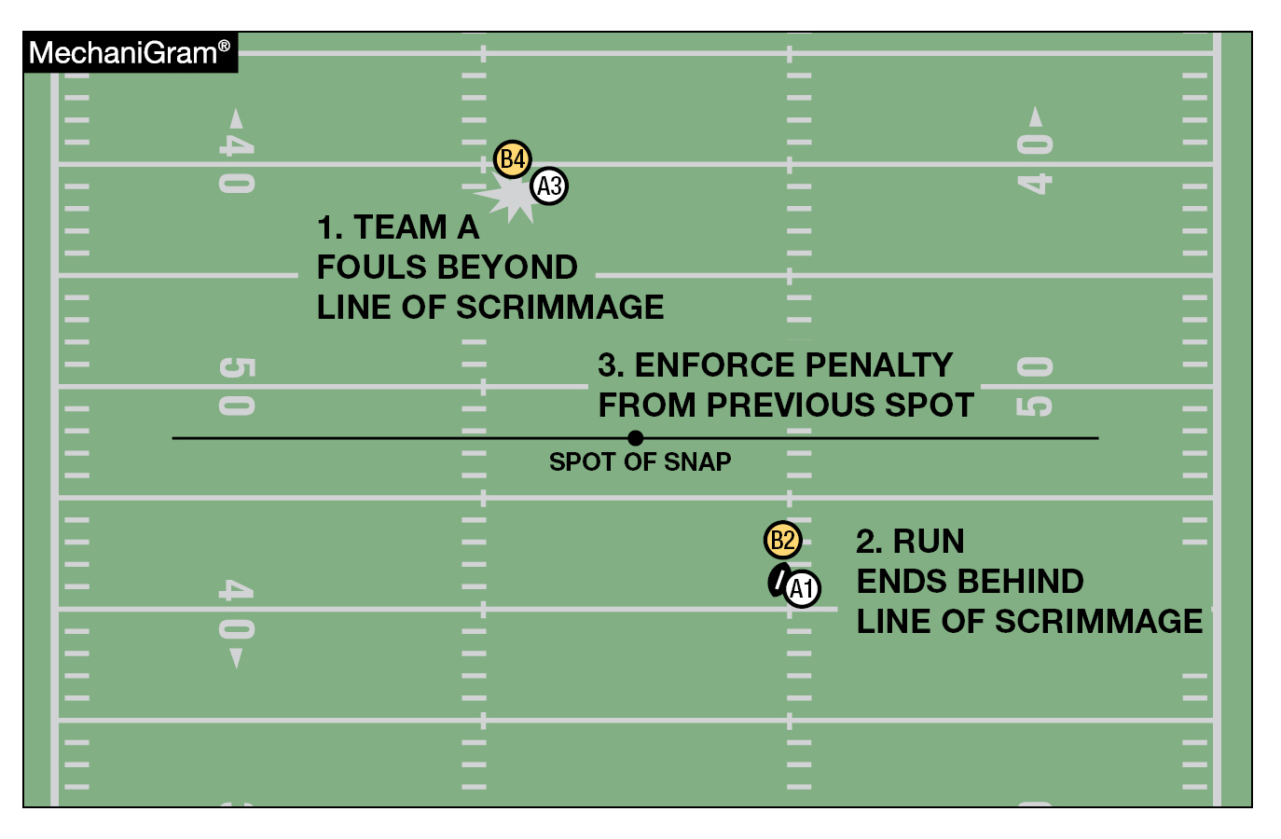
Rule 10-4-2f basic spot for running play penalty enforcement
The basic spot is the previous spot for a foul that occurs beyond the line of scrimmage when the run or related run ends behind the line of scrimmage.
Notes:
Comment on Slide:
See comments on slide.

Slide 19
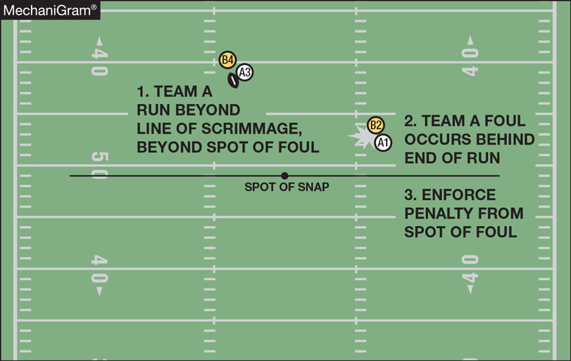
Rule 10-4-4d basic spot for running play penalty enforcement
The basic spot is the spot of the foul by A that occurs beyond the line of scrimmage during a running play as defined in 10-3-2 when the run or related run ends beyond the line of scrimmage and the foul occurs behind the end of the run or related run.
Notes:
Comment on Slide:
See comments on slide.

Slide 20
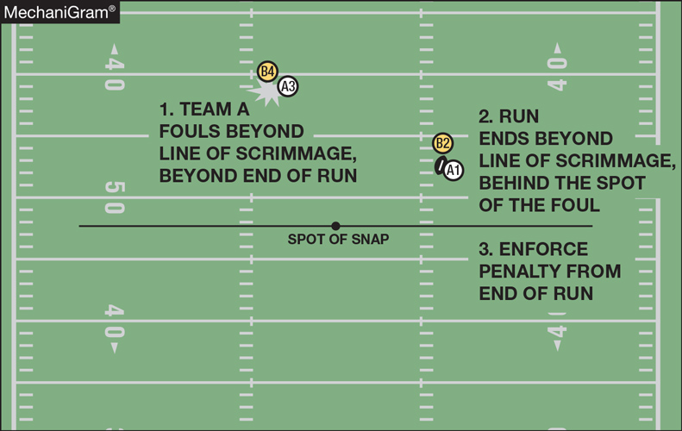
Rule 10-4-5e basic spot for running play penalty enforcement
The basic spot is the spot of the foul for a foul by A that occurs beyond the line of scrimmage during a running play as defined in 10-3-2 when the run or related run ends beyond the line of scrimmage and the foul occurs in advance of the end of the run or related run.
Notes:
Comment on Slide:
See comments on slide.

Slide 21
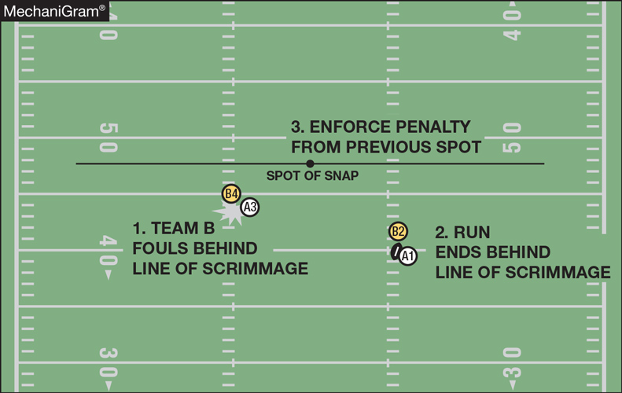
Rule 10-4-2d basic spot for running play penalty enforcement
The basic spot is the previous spot for a foul by B when the run or related run ends behind the line of scrimmage where there is no change of possession.
Notes:
Comment on Slide:
See comments on slide.

Slide 22
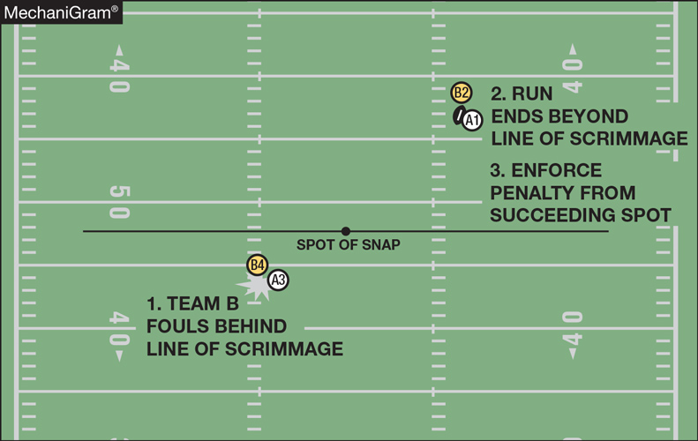
Rule 10-4-5f basic spot for running play penalty enforcement
The basic spot is the succeeding spot for a foul by B when the run or related run ends beyond the line of scrimmage.
Notes:
Comment on Slide:
See comments on slide.

Slide 23
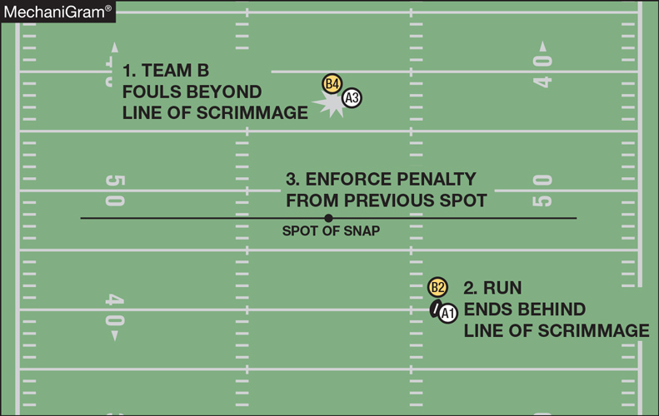
Rule 10-4-2d basic spot for running play penalty enforcement
The basic spot is the previous spot for a foul by B when the run or related run ends behind the line of scrimmage where there is no change of possession.
Notes:
Comment on Slide:
See comments on slide.

Slide 24
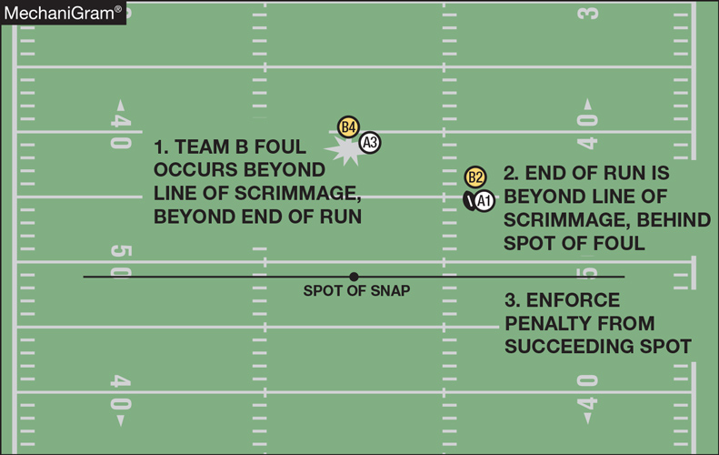
Rule 10-4-5f basic spot for running play penalty enforcement
The basic spot is the succeeding spot for a foul by B when the run or related run ends beyond the line of scrimmage and the foul occurs beyond the end of the run.
Notes:
Comment on Slide:
See comments on slide.

Slide 25
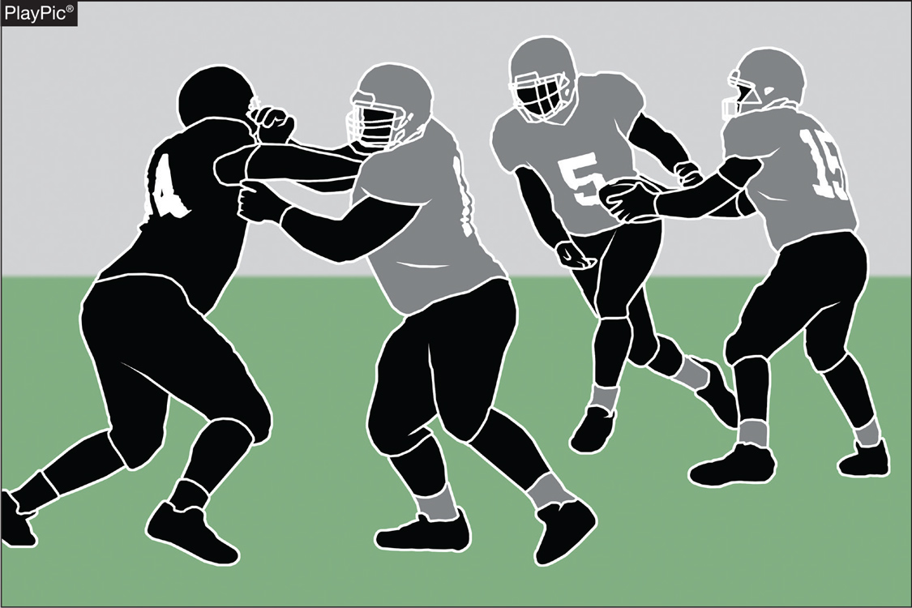
Six-player – rule 7g (NEW)
HANDING THE BALL FORWARD
A direct forward handoff may be made during a scrimmage down before a change of possession, provided both players are in or behind the neutral zone unless it is to the snapper.
Notes:
Rule Change:
SIX-PLAYER
GENERAL: Eleven-player rules are used for six-player football with these listed modifications. …
RULE 7: …
g. A direct forward handoff may be made during a scrimmage down before a change of possession, provided both players are in or behind the neutral zone unless it is to the snapper. …
Rationale for Change:
The change allows the ball to be handed forward on a running play, including to the guards/ends, while prohibiting handing the ball to the snapper provided both players are behind the neutral zone.

Slide 26
2023 nfhs football editorial changes

Slide 27
2023 Nfhs football editorial changes
1-1-7, 1-1-9, 1-3-2, 1-3-7 NOTE, TABLE 1-7 (6), 9-5-1, 9-8-1, RESOLVING TIED GAMES – 3-1 | Changed the words “contest(s)” to “games(s)”.
TABLE 1-7 | Removed the state association accommodation reference.
1-8 | Created a new SECTION 8 for State Association Accommodations.
3-6-1b(1) | Added further clarification that game officials need to be in position when the ball is marked ready for play.
TABLE 7-5 (1) d EXCEPTION 2 | Corrected a misspelling.
FOOTBALL FUNDAMENTALS – II-2 | Grammar correction.
FOOTBALL FUNDAMENTALS – X-3 | Clarified basic spot per Rule 10-4.
Notes:
Comment on Slide:
This slide lists the rules references and a brief description of the football editorial changes that were made to the 2023 NFHS Football Rules Book.

Slide 28
2023 Nfhs football editorial changes
FOOTBALL FUNDAMENTALS – X-5 | Updated the total number of illegal passes.
NINE-, Eight- AND SIX-PLAYER RULES DIFFERENCES – RULES 2 and 7 | Revised the rules differences based off of 2023 NFHS Football Rules Changes.
PENALTY SUMMARY | Updated the rules references for “Delay of Game” and removed the penalty reference for “Intentional Pass Interference.”
INDEX | Updated the Index with new rules references.
Notes:
Comment on Slide:
This slide lists the rules references and a brief description of the football editorial changes that were made to the 2023 NFHS Football Rules Book.

Slide 29
2023 nfhs football rules reminders

Slide 30
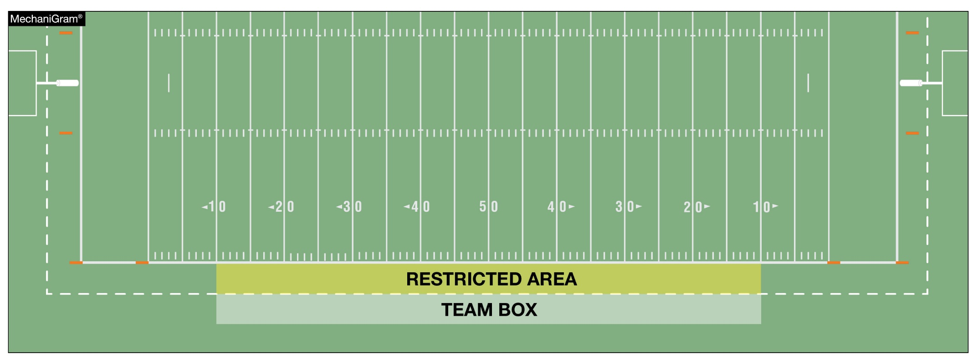
TEAM BOXES rule 1-2-3g NOTES 3. (NEW), TABLE 1-7 (3.) (New)
It is permissible for state associations to approve an extension of the team box and to determine the individuals who may be in the extended area, provided such extension is the same for both teams.
Notes:
Rules Reminder:
RULE 1 – SECTION 2 THE FIELD AND MARKINGS …
ART. 3 . . . Lines and other markings: …
g. Team boxes shall be marked on each side of the field outside the coaches’ area between the 25-yard lines for use of coaches, substitutes, athletic trainers, etc., affiliated with the team. The coaches' area is a minimum of a 2-yard belt between the front of the team box and the sideline, and becomes a restricted area when the ball is live.
NOTES:
1. It is permissible for both team boxes to be on the same side of the field, provided each team box is marked between respective 20- and 45-yard lines.
2. It is recommended goal lines and the team box boundaries be marked in a color which contrasts with other field markings and the area between the sidelines and the team box boundaries be solid white or marked with diagonal lines.
3. It is permissible for state associations to approve an extension of the team box and to determine the individuals who may be in the extended area, provided such extension is the same for both teams.
RULE 1 – TABLE 1-7 – TABLE OF STATE ASSOCIATION ADOPTIONS …
3. Approve an extension of the team box if the same for both teams. (1-2-3g NOTE 3)
Rationale for Change:
2022 Rule Change - By state association adoption, the team box may now be extended beyond the 25-yard line.

Slide 31
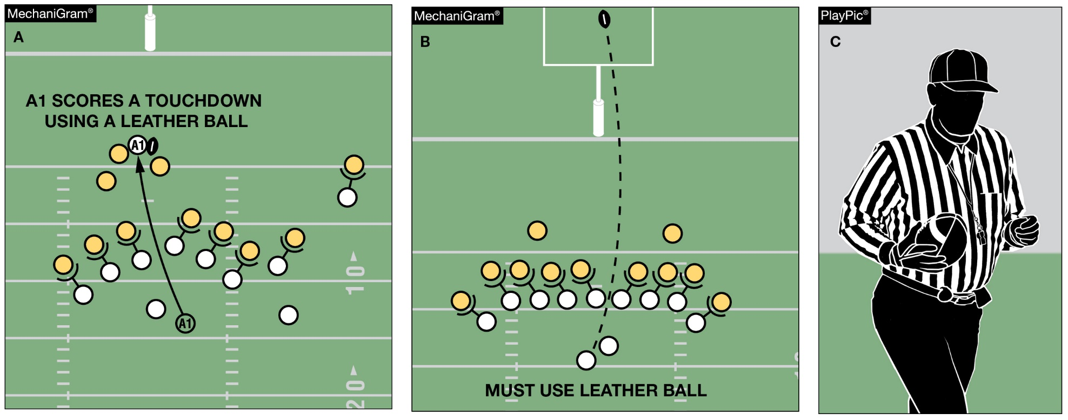
Game balls rule 1-3-3
Any game official may order the ball changed between downs. Unless the ball is ordered changed by the Referee or another game official, Team A scoring a touchdown with one ball (MechaniGram A) may not request a different ball for the try (MechaniGram B) but may use a different approved ball for the ensuing free kick (PlayPic C).
Notes:
Rule Change:
RULE 1 – SECTION 3 GAME EQUIPMENT …
ART. 3 . . . The referee shall decide whether the ball meets specifications, and the referee or any other game official may order the ball changed between downs.
Rationale for Change:
2022 Rule Change - Any game official may order the ball changed between downs.
Case Book: See SITUATIONS 1.3.3A, 1.3.3B

Slide 32
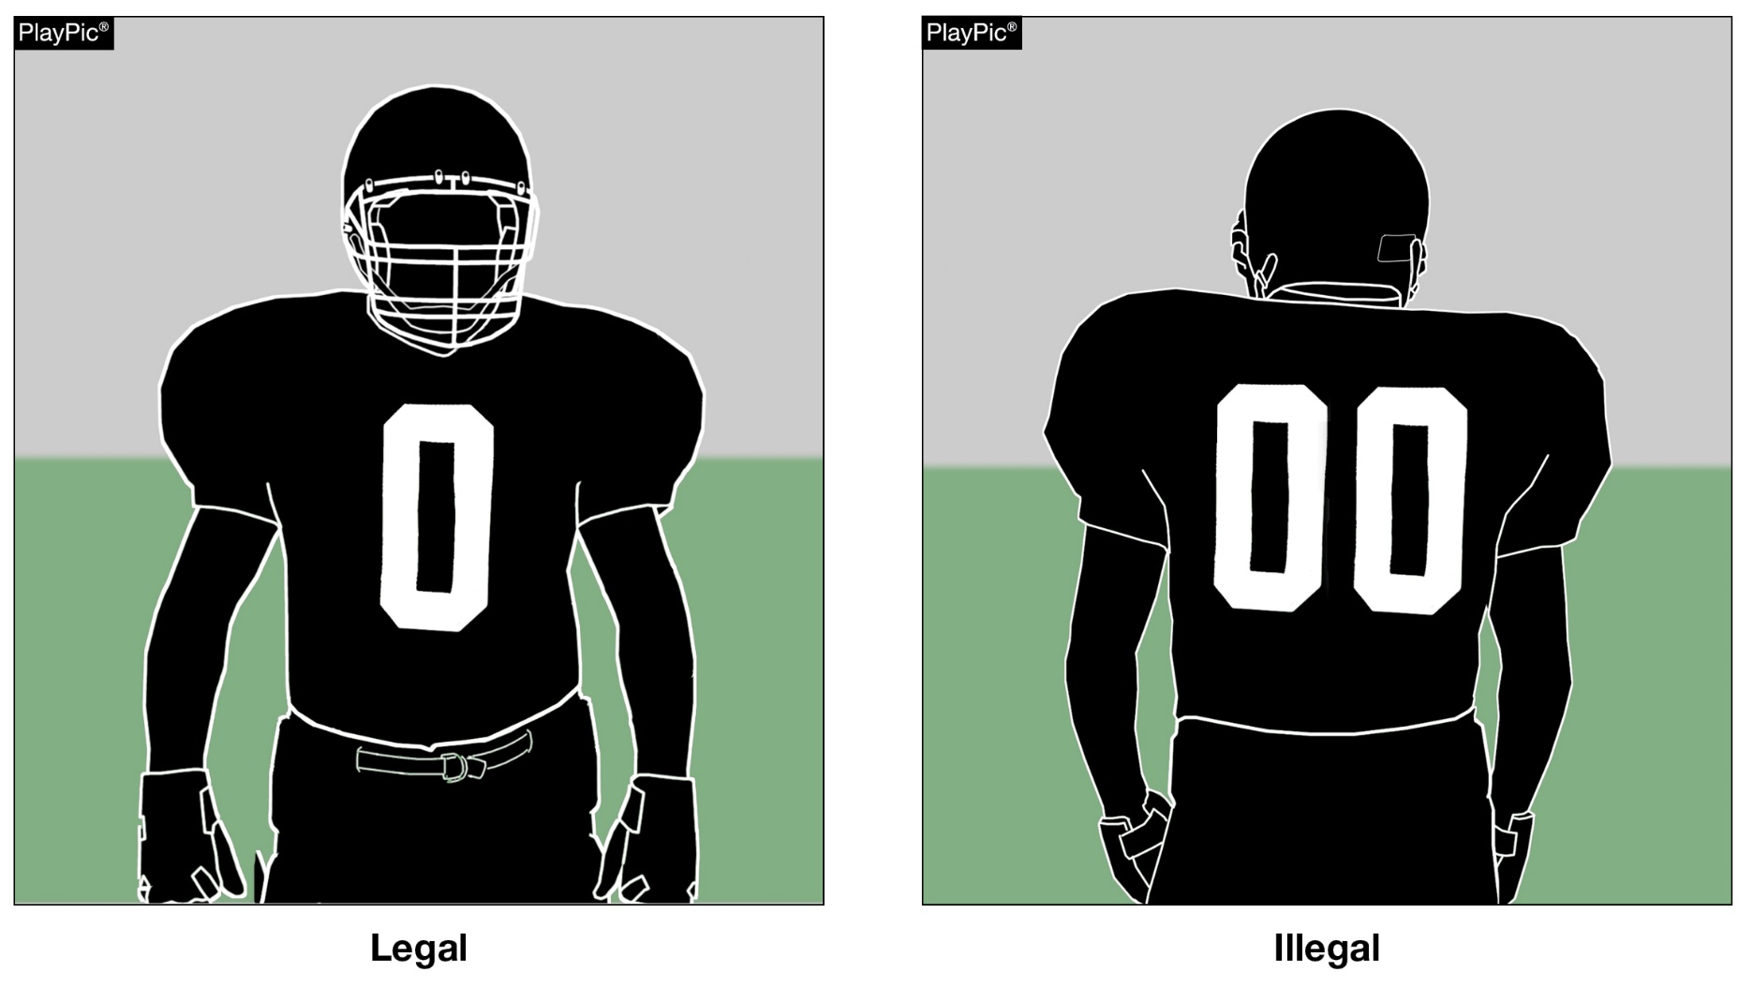
Jersey numbers rule 1-4-3, FIGURE 1-4-2, Rule 1-5-1c(1), rule 7-2-5b EXCEPTIONS, RULE 7-5-6a
Each player shall be numbered 0 though 99 inclusive. Any number preceded by the digit zero such as “00” is illegal.
Notes:
Rule Change:
RULE 1 – SECTION 4 PLAYER DESIGNATIONS …
ART. 3 . . . Each player shall be numbered 0 through 99 inclusive. Any number preceded by the digit zero is illegal. See 7-2-5.
RULE 1 – SECTION 5 PLAYER EQUIPMENT …
ART. 1 . . . Mandatory equipment. Each player shall participate while wearing the following pieces of properly fitted equipment, which shall be professionally
manufactured and not altered to decrease protection: …
c. Numbers
The numbers shall be clearly visible and legible using Arabic numbers 0-99 inclusive and shall be on the front and back of the jersey.
RULE 7 – SECTION 2 FORMATION/POSITION, NUMBERSING AND ACTION AT THE SNAP …
ART. 5 . . . Player formation and numbering requirements include:
a. No more than four A players may be backs and only one A player
b. At the snap, at least five A players on their line of scrimmage must be numbered 50-79.
EXCEPTIONS:
1. On first, second or third down, when A sets or shifts into a scrimmage-kick formation as in 2-14-2a, the snapper may be a player numbered 0 to 49 or 80 to 99. If Team A has the snapper in the game under this exception, Team A shall have four players wearing numbers 50-79 on its line of scrimmage. The snapper in the game under this exception must be between the ends and is an ineligible forward-pass receiver during that down unless the pass is touched by B (7-5-6b).
2. On fourth down or during a kick try, when A sets or shifts into a scrimmage-kick formation, any A player numbered 0 to 49 or 80 to 99 may take the position of any A player numbered 50 to 79. A player in the game under this exception must assume an initial position on his line of scrimmage between the ends and he remains an ineligible forward-pass receiver during that down unless the pass is touched by B (7-5-6b).
RULE 7 – SECTION 5 FORWARD-PASS CLASSIFICATION …
ART. 6 . . . Pass eligibility rules apply only to a legal forward pass. The following players are eligible pass receivers:
All A players eligible by position and number including those who, at the time of the snap, are on the ends of their scrimmage line or legally behind the line (possible total of six) and are numbered 0-49 or 80-99. (7-2-5b EXCEPTION 2)
Rationale for Change:
2022 Rule Change - The single digit number "0" is now a legal number.
Case Book: See SITUATION 1.4.3

Slide 33
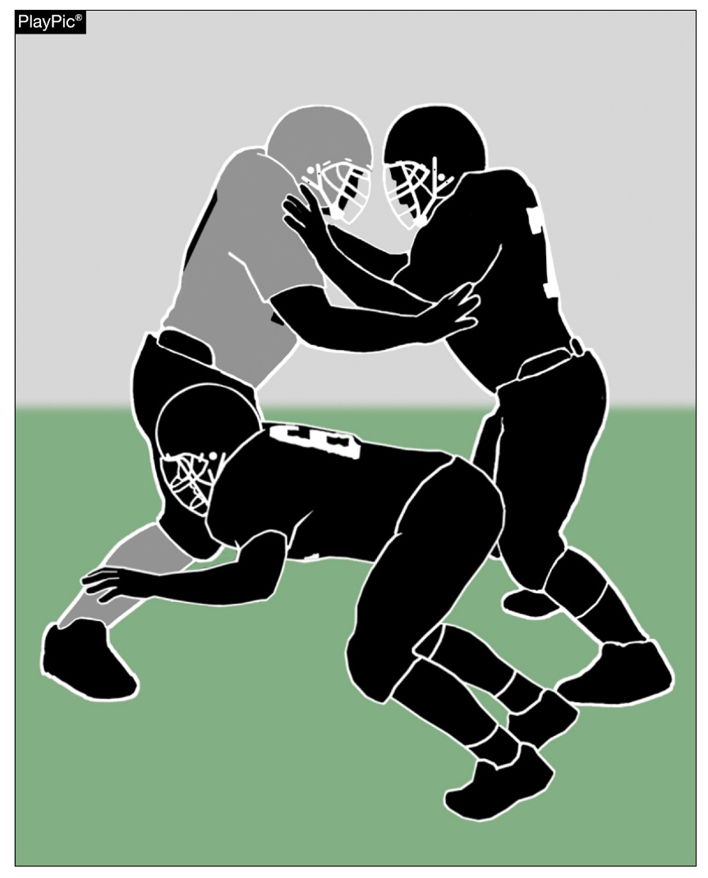
CHOP BLOCK
RULE 2-3-8
A chop block is combination block by two or more teammates against an opponent other than the runner, with or without delay, where one of the blocks is below the waist and one of the blocks is above the waist.
Notes:
Rule Change:
RULE 2 – SECTION 3 BLOCKING …
ART. 8 . . . Chop block is a combination block by two or more teammates against an opponent other than the runner, with or without delay, where one of the blocks is below the waist and one of the blocks is above the waist.
Rationale for Change:
2022 Rule Change - A chop block has been redefined as an illegal combination block where contact is made above and below the waist.
Case Book: See SITUATION 9.3.2F

Slide 34
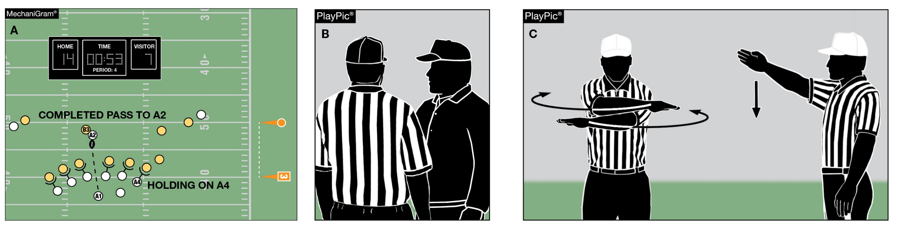
Game clock option
RULE 3-4-7
When a foul is committed with less than two minutes remaining in either half, the offended team has the option to start the game clock on the snap. In MechaniGram A, Team B trails when Team A fouls. Team B’s coach is consulted (PlayPic B), choosing to decline the penalty and have the clock started on the snap (PlayPic C).
Notes:
Rule Change:
RULE 3 – SECTION 4 STARTING AND STOPPING THE GAME CLOCK …
ART. 7 . . . When a foul is committed with less than two minutes remaining in either half, the offended team will have the option to start the game clock on the snap.
Rationale for Change:
2022 Rule Change - Changed the offended team's game clock options following a foul committed with less than two minutes remaining in either half.
Case Book: See SITUATIONS 3.4.7A, 3.4.7C, 3.4.7D

Slide 35
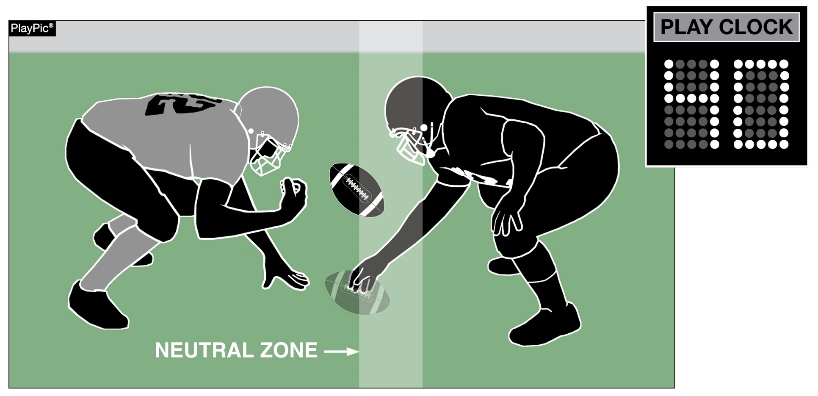
PLAY CLOCK
RULE 3-6-1a(1)e EXCEPTION 2. (NEW)
When the clock is stopped due to Rule 3-5-7i and Team B is the only team to foul, the play clock will be set to 40 seconds.
Notes:
Rule Change:
RULE 3 – SECTION 6 PLAY CLOCK, BALL READY FOR PLAY AND DELAY …
ART. 1 . . . Play clock and ready-for-play:
a. Play clock:
1. 25 seconds will be on the play clock and start on the ready-for-play signal:
(a) Prior to a try following a score;
(b) To start a period or overtime series;
(c) Following administration of an inadvertent whistle;
(d) Following a charged time-out;
(e) Following an official's time-out as in 3-5-7 or 3-5-10.
EXCEPTIONS:
1. 3-5-7b;
2. 3-5-7e, 3-5-7i or 3-5-10 if related to a defensive player.
Rationale for Change:
2022 Rule Change - Added a new exception to the play clock administration following a foul committed only by the defensive team.

Slide 36
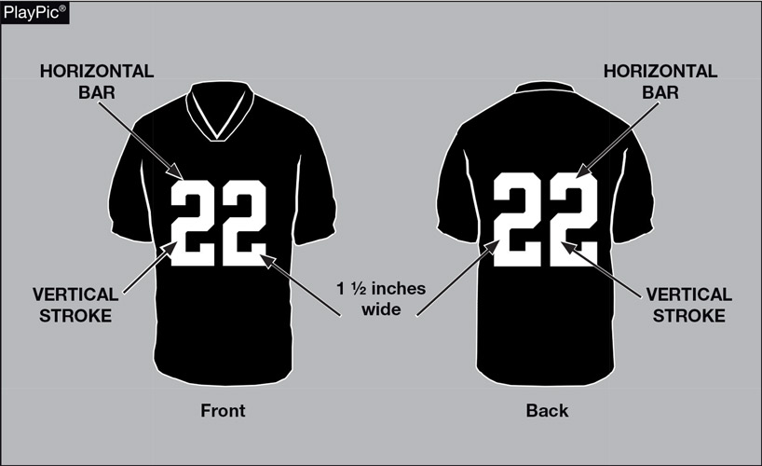
FOOTBALL JERSEY NUMBERS
RULE 1-5-1c(3)
The entire body of the number (the continuous horizontal bars and vertical strokes) exclusive of any border(s) shall be approximately 1 1/2 – inches wide.
Notes:
Rules Reminder:
RULE 1 – SECTION 5 – PLAYER EQUIPMENT
ART. 1 . . . Mandatory equipment. Each player shall participate while wearing the following pieces of properly fitted equipment, which shall be professionally manufactured and not altered to decrease protection: …
c. Numbers
1. The numbers shall be clearly visible and legible using Arabic numbers 0-99 inclusive and shall be on the front and back of the jersey.
2. The numbers, inclusive of any border(s), shall be centered horizontally at least 8 inches and 10 inches high on front and back, respectively.
3. The entire body of the number (the continuous horizontal bars and vertical strokes) exclusive of any border(s) shall be approximately 1½-inches wide.
4. The color and style of the number shall be the same on the front and back.
5. Through the 2023 season, the body of the number (the continuous horizontal bars and vertical strokes) shall be either:
(a) a continuous color(s) contrasting with the jersey color; or
(b) the same solid color(s) as the jersey with a minimum of one border that is at least ¼-inch in width of a single solid contrasting color.
6. Effective with the 2024 season, the entire body of the number (the continuous horizontal bars and vertical strokes) shall be a single solid color that clearly contrasts with the body color of the jersey.
Comment on Slide:
Rule change in 2019. The purpose of numbers on jerseys is to provide clear identification of players. In order to enhance the ability to easily identify players, the committee has clarified the size requirements for jersey numbers through the 2023 season. The committee also added a new requirement that, effective in the 2024 season, jersey numbers must be a single solid color that clearly contrasts with the body color of the jersey.

Slide 37
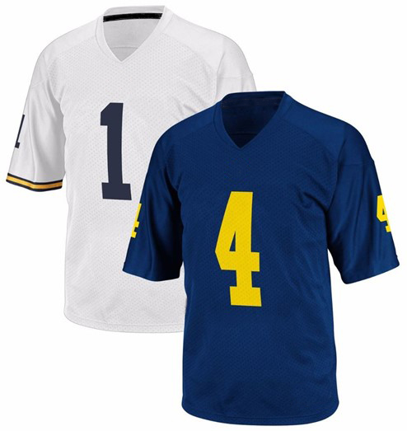
2024 - Football JERSEY numbers
RULES 1-5-1c; 1-5-1c(6)
Effective with the 2024 season, the entire body of the number (the continuous horizontal bars and vertical strokes) shall be a single solid color that clearly contrasts with the body color of the jersey.
Notes:
Rules Reminder:
Comment on Slide:
See comments on slide.

Slide 38
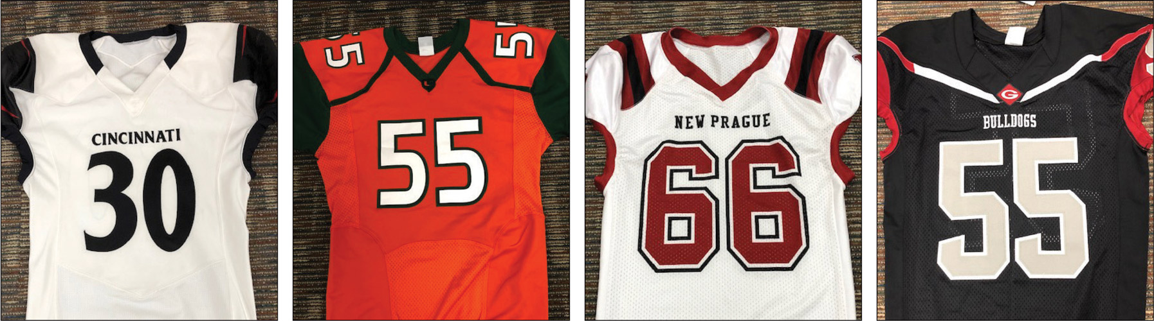
2024 – Football JERSEY numbers
RULES 1-5-1c; 1-5-1c(6)
A
B
C
D
The style of the numbers on all four of these jerseys are legal now and will be in 2024 too.
.
Notes:
Rules Reminder:
RULE 1 – SECTION 5 – PLAYER EQUIPMENT
ART. 1 . . . Mandatory equipment. Each player shall participate while wearing the following pieces of properly fitted equipment, which shall be professionally manufactured and not altered to decrease protection: …
c. Numbers
1. The numbers shall be clearly visible and legible using Arabic numbers 0-99 inclusive and shall be on the front and back of the jersey.
2. The numbers, inclusive of any border(s), shall be centered horizontally at least 8 inches and 10 inches high on front and back, respectively.
3. The entire body of the number (the continuous horizontal bars and vertical strokes) exclusive of any border(s) shall be approximately 1½-inches wide.
4. The color and style of the number shall be the same on the front and back.
5. Through the 2023 season, the body of the number (the continuous horizontal bars and vertical strokes) shall be either:
(a) a continuous color(s) contrasting with the jersey color; or
(b) the same solid color(s) as the jersey with a minimum of one border that is at least ¼-inch in width of a single solid contrasting color.
6. Effective with the 2024 season, the entire body of the number (the continuous horizontal bars and vertical strokes) shall be a single solid color that clearly contrasts with the body color of the jersey.
Comment on Slide:
Rule change in 2019. The purpose of numbers on jerseys is to provide clear identification of players. In order to enhance the ability to easily identify players, the committee has clarified the size requirements for jersey numbers through the 2023 season. The committee also added a new requirement that, effective in the 2024 season, jersey numbers must be a single solid color that clearly contrasts with the body color of the jersey.

Slide 39
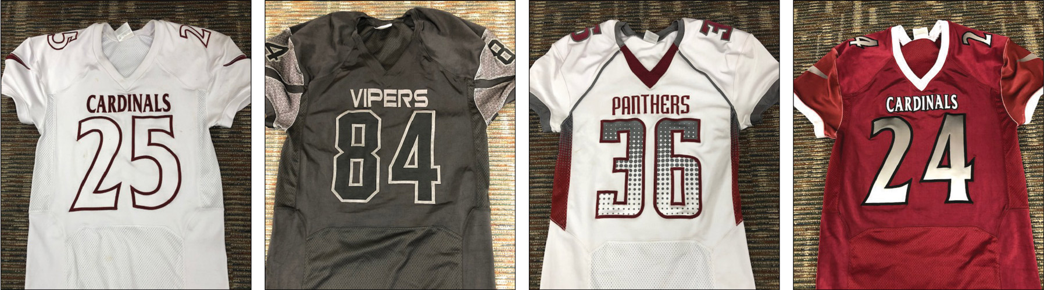
2024 – Football JERSEY numbers
RULES 1-5-1c; 1-5-1c(6)
A
B
C
D
The style of the numbers on these jerseys are legal through the 2023 season. The following four types of number designs will be illegal in 2024.
Notes:
Rules Reminders:
RULE 1 – SECTION 5 – PLAYER EQUIPMENT
ART. 1 . . . Mandatory equipment. Each player shall participate while wearing the following pieces of properly fitted equipment, which shall be professionally manufactured and not altered to decrease protection: …
c. Numbers
1. The numbers shall be clearly visible and legible using Arabic numbers 0-99 inclusive and shall be on the front and back of the jersey.
2. The numbers, inclusive of any border(s), shall be centered horizontally at least 8 inches and 10 inches high on front and back, respectively.
3. The entire body of the number (the continuous horizontal bars and vertical strokes) exclusive of any border(s) shall be approximately 1½-inches wide.
4. The color and style of the number shall be the same on the front and back.
5. Through the 2023 season, the body of the number (the continuous horizontal bars and vertical strokes) shall be either:
(a) a continuous color(s) contrasting with the jersey color; or
(b) the same solid color(s) as the jersey with a minimum of one border that is at least ¼-inch in width of a single solid contrasting color.
6. Effective with the 2024 season, the entire body of the number (the continuous horizontal bars and vertical strokes) shall be a single solid color that clearly contrasts with the body color of the jersey.
Comment on Slide:
Rule change in 2019. The purpose of numbers on jerseys is to provide clear identification of players. In order to enhance the ability to easily identify players, the committee has clarified the size requirements for jersey numbers through the 2023 season. The committee also added a new requirement that, effective in the 2024 season, jersey numbers must be a single solid color that clearly contrasts with the body color of the jersey.

Slide 40
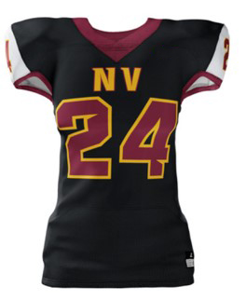
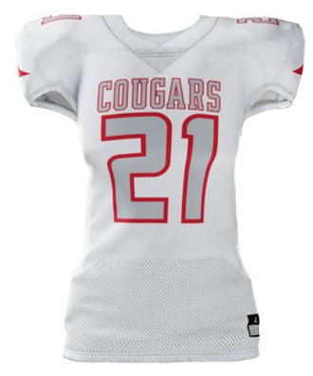
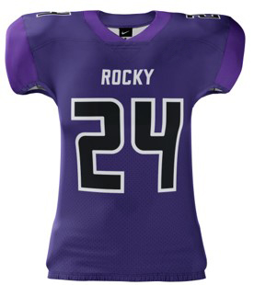
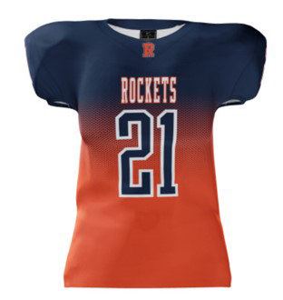
2024 – Football JERSEY numbers
RULES 1-5-1c, 1-5-1c(6)
The style of the numbers on these jerseys are legal through the 2023 season.
The dark number without the border do not clearly contrast with the jersey and thus will not be legal come 2024.
Notes:
Rules Reminders:
RULE 1 – SECTION 5 – PLAYER EQUIPMENT
ART. 1 . . . Mandatory equipment. Each player shall participate while wearing the following pieces of properly fitted equipment, which shall be professionally manufactured and not altered to decrease protection: …
c. Numbers
1. The numbers shall be clearly visible and legible using Arabic numbers 1-99 inclusive and shall be on the front and back of the jersey.
2. The numbers, inclusive of any border(s), shall be centered horizontally at least 8 inches and 10 inches high on front and back, respectively.
3. The entire body of the number (the continuous horizontal bars and vertical strokes) exclusive of any border(s) shall be approximately 1½-inches wide.
4. The color and style of the number shall be the same on the front and back.
5. Through the 2023 season, the body of the number (the continuous horizontal bars and vertical strokes) shall be either:
(a) a continuous color(s) contrasting with the jersey color; or
(b) the same solid color(s) as the jersey with a minimum of one border that is at least ¼-inch in width of a single solid contrasting color.
6. Effective with the 2024 season, the entire body of the number (the continuous horizontal bars and vertical strokes) shall be a single solid color that clearly contrasts with the body color of the jersey.
Comment on Slide:
Rule change in 2019. The purpose of numbers on jerseys is to provide clear identification of players. In order to enhance the ability to easily identify players, the committee has clarified the size requirements for jersey numbers through the 2023 season. The committee also added a new requirement that, effective in the 2024 season, jersey numbers must be a single solid color that clearly contrasts with the body color of the jersey.

Slide 41
2023 nfhs football points of emphasis

Slide 42
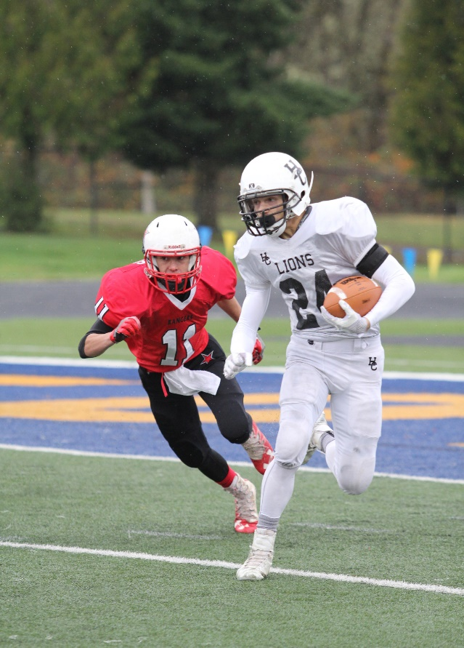
2023 nfhs football points of emphasis
1. Helping the Runner
Communication Between Coaches and
Game Officials
3. Game Management
Notes:
Comment on Slide:
The following football points of emphasis were selected by the NFHS Football Rules Committee for the 2023 high school football season. These three football points of emphasis need to be stressed to all coaches, game officials, players, parents, school administrators, appropriate health-care professionals and all others who have an interest in high school football.

Slide 43
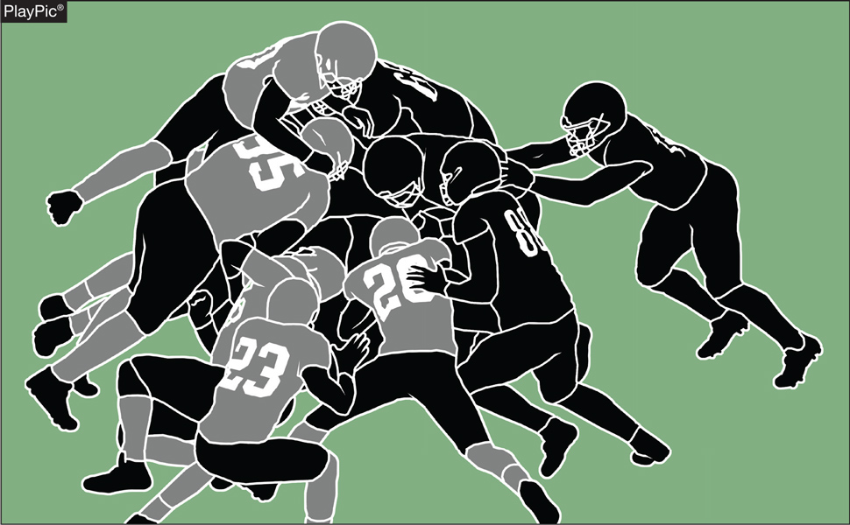
HELPING THE RUNNER
Rule changes have been made at higher levels allowing offensive teams to pile in behind and directly push the runner. Similar plays are trickling down to the high school level. Allowing teams to help the runner by illegal techniques swings the balance heavily in favor of the offense. Pushing the pile is legal; direct contact and pushing, pulling, lifting of the runner is not.
Notes:
Helping The Runner (Point of Emphasis):
Rule changes have been made at higher levels of football allowing offensive teams to pile in behind and directly push the runner. Because of these changes, we are now seeing similar plays at the high school level. As guardians of the game, it is imperative that all stakeholders work together to remove “helping the runner” from our high school game.
Administrators, coaches and football game officials all have a responsibility to know, respect and teach/enforce the NFHS rules of high school football. Football is a vigorous, physical contact game and, for this reason, much attention is given to minimizing risk of injury to all players. Each respective rules code (NFL, NCAA and NFHS) has rules that coincide with the physical development of competing athletes and their goals for the game.
The NFHS Football Rules Committee’s main focus is risk minimization, followed closely by assurance of a balance between offensive and defensive rules. Because the players on defense must guard against the pass, they are not able to counter the advantages created by “helping the runner” formations. Allowing teams to help the runner by illegal techniques swings the balance heavily in favor of the offense.
Football game officials need to change their view of “helping the runner” to a risk issue (clipping, chop block) and remove it from the “pioneer call” category and refocus on ending plays when forward progress is stopped. Pushing the pile is legal; direct contact and pushing, pulling, lifting of the runner is not.
The NFHS Coaches Code of Ethics states: “Coaches shall master the contest rules and shall teach the rules to their team members. Coaches shall not seek an advantage by circumvention of the spirit or letter of the rules. Coaches have a tremendous influence, for good or ill, on the education of the student, and thus shall never place the value of winning above the value of instilling the highest ideals of character.”
If school administrators/athletic directors truly believe that activities are an extension of the classroom, they must be actively involved with programs they supervise and redirect coaches when they observe them teaching prohibited tactics.
Removing “helping the runner” from high school football will at times be met with resistance. School administrative support of football game officials, re-focus of coaches and education of players will lead to a smooth transition. All those directly involved in our great game must stay committed to trying to minimize risk to all players and maintaining the balance between offensive and defensive play.

Slide 44
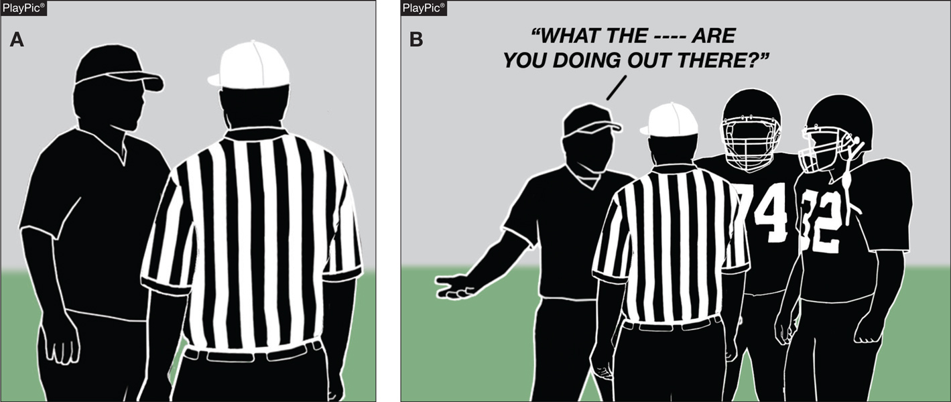
COMMUNICATION BETWEEN COACHES AND GAME OFFICIALS
Game officials must actively listen to what a coach is saying, then respond factually and unemotionally (PlayPic A). If coaches show little respect for game officials and make derogatory comments, their players will likely treat game officials similarly (PlayPic B).
Notes:
Communication Between Coaches and Game Officials (Point of Emphasis):
Coaches and game officials must demonstrate respect for one another. This mutual appreciation is the foundation of appropriate and professional communication.
Football is an emotional game. Coaches and game officials must realize that competition often leads to intense interactions on the field. Both must work together and strive to manage verbal and nonverbal exchanges in ways that avoid escalating conflict.
Game officials must recognize their role in the game: to provide a service to the coaches and student-athletes in an unemotional and impartial manner. Game officials must always be respectful and maintain a calm demeanor in their comments to coaches, especially when tension is high. Game officials must avoid the urge to argue with coaches who disagree with their decisions. Coaches may ask questions, and game officials should make every effort to be approachable, actively listen, and provide correct and complete answers as soon as possible. Game officials should aim to be direct and concise in their communication of essential information.
When emotions are running especially high, game officials should de-escalate tensions and demonstrate empathy and understanding of the coach’s perspective. Game officials must anticipate circumstances where coaches may become upset and pre-emptively diffuse the situation. A game official should never threaten the coach with consequences for their behavior, nor should a game official become defensive. If a coach exhibits inappropriate behavior and “crosses a line,” the game official may choose to penalize the coach for unsportsmanlike conduct. However, throwing a flag should be a last resort. A better approach is to clearly and calmly tell the coach that the comments or behavior are unacceptable, and that it’s difficult to focus on the on-field action if the coach continues to distract the game official.
Coaches model acceptable and unacceptable behavior for their student-athletes. If coaches disrespect game officials and make derogatory comments, players will behave in the same way. Coaches should win with grace and lose with dignity. Coaches must understand that the football field is an extension of the classroom and must exhibit proper conduct. This includes respecting the decisions of game officials even when they disagree, and handling differences of opinion in a civil and dignified manner. Dialogue with game officials should be constructive and respectful, not confrontational. Handling disagreements in a business-like manner teaches players good sportsmanship, which is a perennial focus of the NFHS.
Coaches and game officials have a professional responsibility to demonstrate respect for one another and communicate appropriately. Coaches and game officials love the game and desire to positively impact young people. Proper communication during competition teaches players a valuable life lesson about conflict resolution.

Slide 45
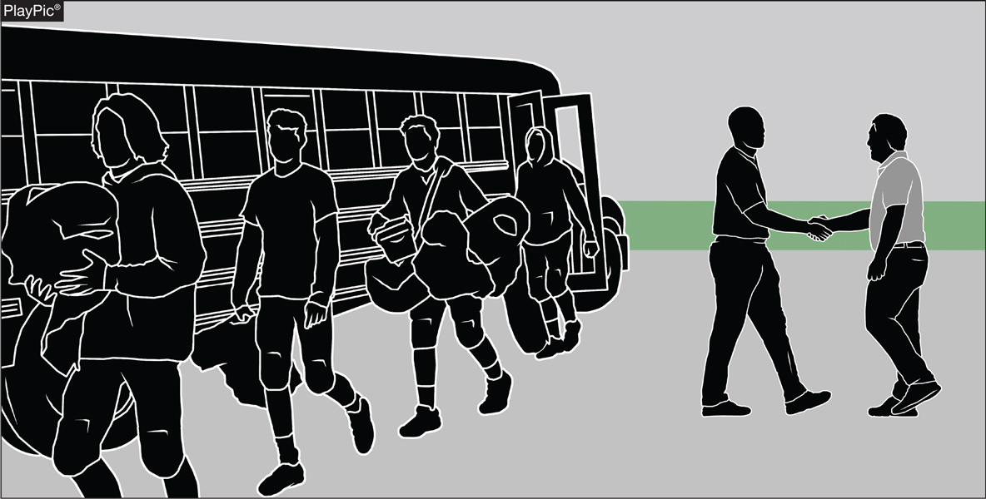
GAME MANAGEMENT
Each school community must take pride in hosting an athletic contest or event. Beginning with the arrival of players, game officials and spectators, each school must have a purposeful plan to address any and all expected issues, as well as the unforeseen. Meeting and greeting the visiting team is certainly the beginning of good sportsmanship. Clearly communicated information, such as parking information, location of ticket booths and entry gates, when given to the visitors is another step in assuring a great experience for all participants.
Notes:
Game Management (Point of Emphasis):
Each school community must take pride in hosting an athletic contest or event. Proper advance planning is key to an orderly, secure, safe and enjoyable activity. Planning begins with clearly defined tasks for game administration and event personnel. Beginning with the arrival of players, game officials and spectators, each school must have a purposeful plan to address any and all expected issues, as well as the unforeseen.
Preparation begins with clear and concise communication between the host and the competing school regarding the logistics of arrival and departure. Meeting and greeting the visiting team is certainly the beginning of good sportsmanship. Clearly communicated information, such as parking information, location of ticket booths and entry gates, when given to the visitors is another step in assuring a great experience for all participants.
Game officials should be afforded the same communication considerations given the visiting school community. Host administration must provide accurate information for the officiating crew so as to ease any pre-game apprehension or uncertainty. Clear, concise communication is of utmost importance. Having assigned personnel to greet game officials and address all their pre-game and post-game needs is a bare minimum for the host school. Security of game officials must be an absolute priority. Make sure the locker room is properly supervised and access is limited to proper personnel only.
During the game, security of game personnel begins with ensuring that the sideline is properly secured and the playing field is restricted to essential game personnel. For safety and security reasons, essential game personnel would include game participants, reporters, photographers and game administration. All other, non-essential personnel should be located in the bleachers. All non-participants on the event level should be credentialed and restricted to being no closer than 2 yards from the sideline. Game officials are responsible for securing the team boxes and coaches’ area. Sideline management begins with the consistent enforcement of game rules pertaining to the restricted area and the team box. The restricted area is designated to make the sidelines safe for all participants and to give game officials ample space to work. Game administration should be alert to requests of game officials in addressing problems beyond the team box and coaches’ area.
The conduct of non-participants is the domain of game and school administration. Expectations for the behavior of spectators and other attendees should be clearly, and repeatedly, communicated to all attendees. The reading of a sportsmanship script before the game is one method of communicating expectations. Good sportsmanship must become part of the culture of any school community. Behavior not acceptable in the school’s hallways should not be acceptable on the courts or playing fields.
Appropriate conduct of the public-address announcer is vital to the game atmosphere. The public address announcer must be the first line of sportsmanship and must exemplify expected and acceptable conduct. The goal of the public-address announcer is to inform and not entertain. Giving play-by-play of game action and/ or critiquing game officials is unacceptable. The public-address announcer must be positive and respectful to all involved in the game.
MINIMAL GAME ADMINISTRATION EXPECTATIONS
• Clearly communicated event itinerary
• Required field markings and game equipment
• Clock operator(s)
• Line-to-gain crew
• Game Official accommodations
• Visiting team accommodations
• Support personnel
• Medical personnel
• Security personnel
• Hospitality for game personnel and administration, inclusive of game officials

Slide 46
2023-24 NFHS Football information

Slide 47

2024 nfhs football rule change proposal online form
Due:
November 1, 2023
Must be submitted to your state association office for approval.
Notes:
Comment on Slide:
ALL 2024 NFHS Football Rule Change Proposal Online Forms must first go through the state association office before it can be sent to the NFHS.
Only member state associations, football coaches and football game officials approved by the member state association, members of the NFHS Football Rules Committee and the NFHS can submit football rule change online proposal forms.
ALL 2024 NFHS Football Rule Change Online Proposal Forms must be submitted electronically online to the NFHS by November 1, 2023.

Slide 48
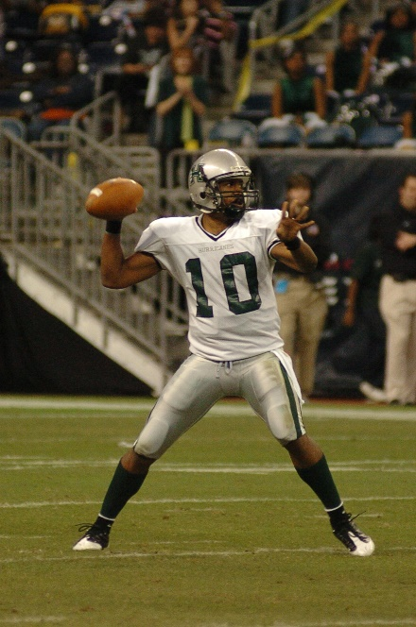
2023-24 nfhs football information
2023 In-Person NFHS Football Rules State Interpreters Meeting
  June 29, 2023 (NFHS Summer Meeting – Seattle, WA)
  4:30 p.m. (Pacific Time)
2023 Online Mid-Season NFHS Football Rules Webinar
  September 25, 2023
  2:00 p.m. (Eastern Time)
2024 NFHS Football Rule Change Proposal Form Due
  November 1, 2023
2024 NFHS Football Rules Committee Meeting
  January 14-16, 2024
  Indianapolis, Indiana
Notes:
Comment on Slide:
2023-24 NFHS information with regards to football.

Slide 49
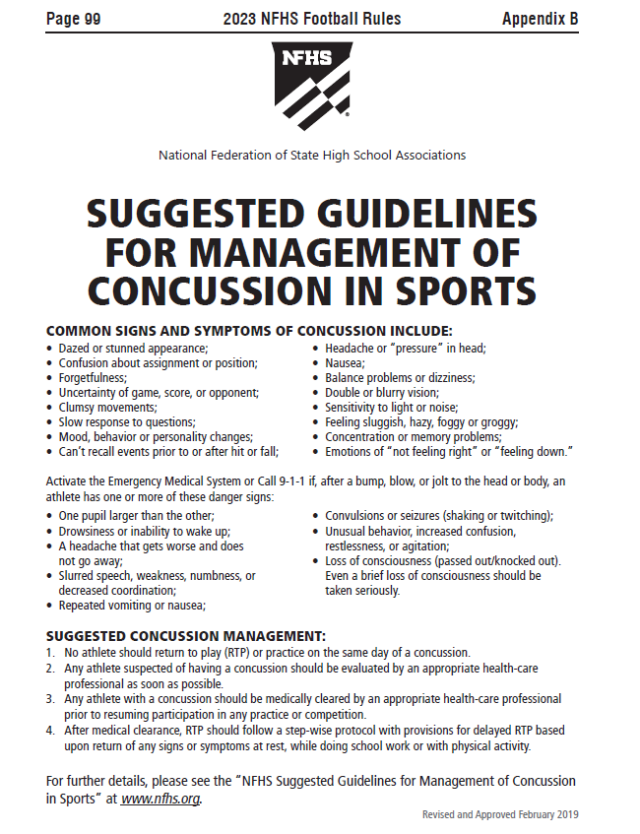
Nfhs suggested guidelines For management of concussion in sports
In the Appendix
in all of the
2023-24 NFHS
Rules Book
Notes:
Comment on Slide:
The “NFHS Suggested Guidelines for Management of Concussion” is in the Appendix in all of the 2023-24 NFHS Rules Books and was developed by the NFHS Sports Medicine Advisory Committee (SMAC).

Slide 50
NFHS OFFICIALS Education

Slide 51
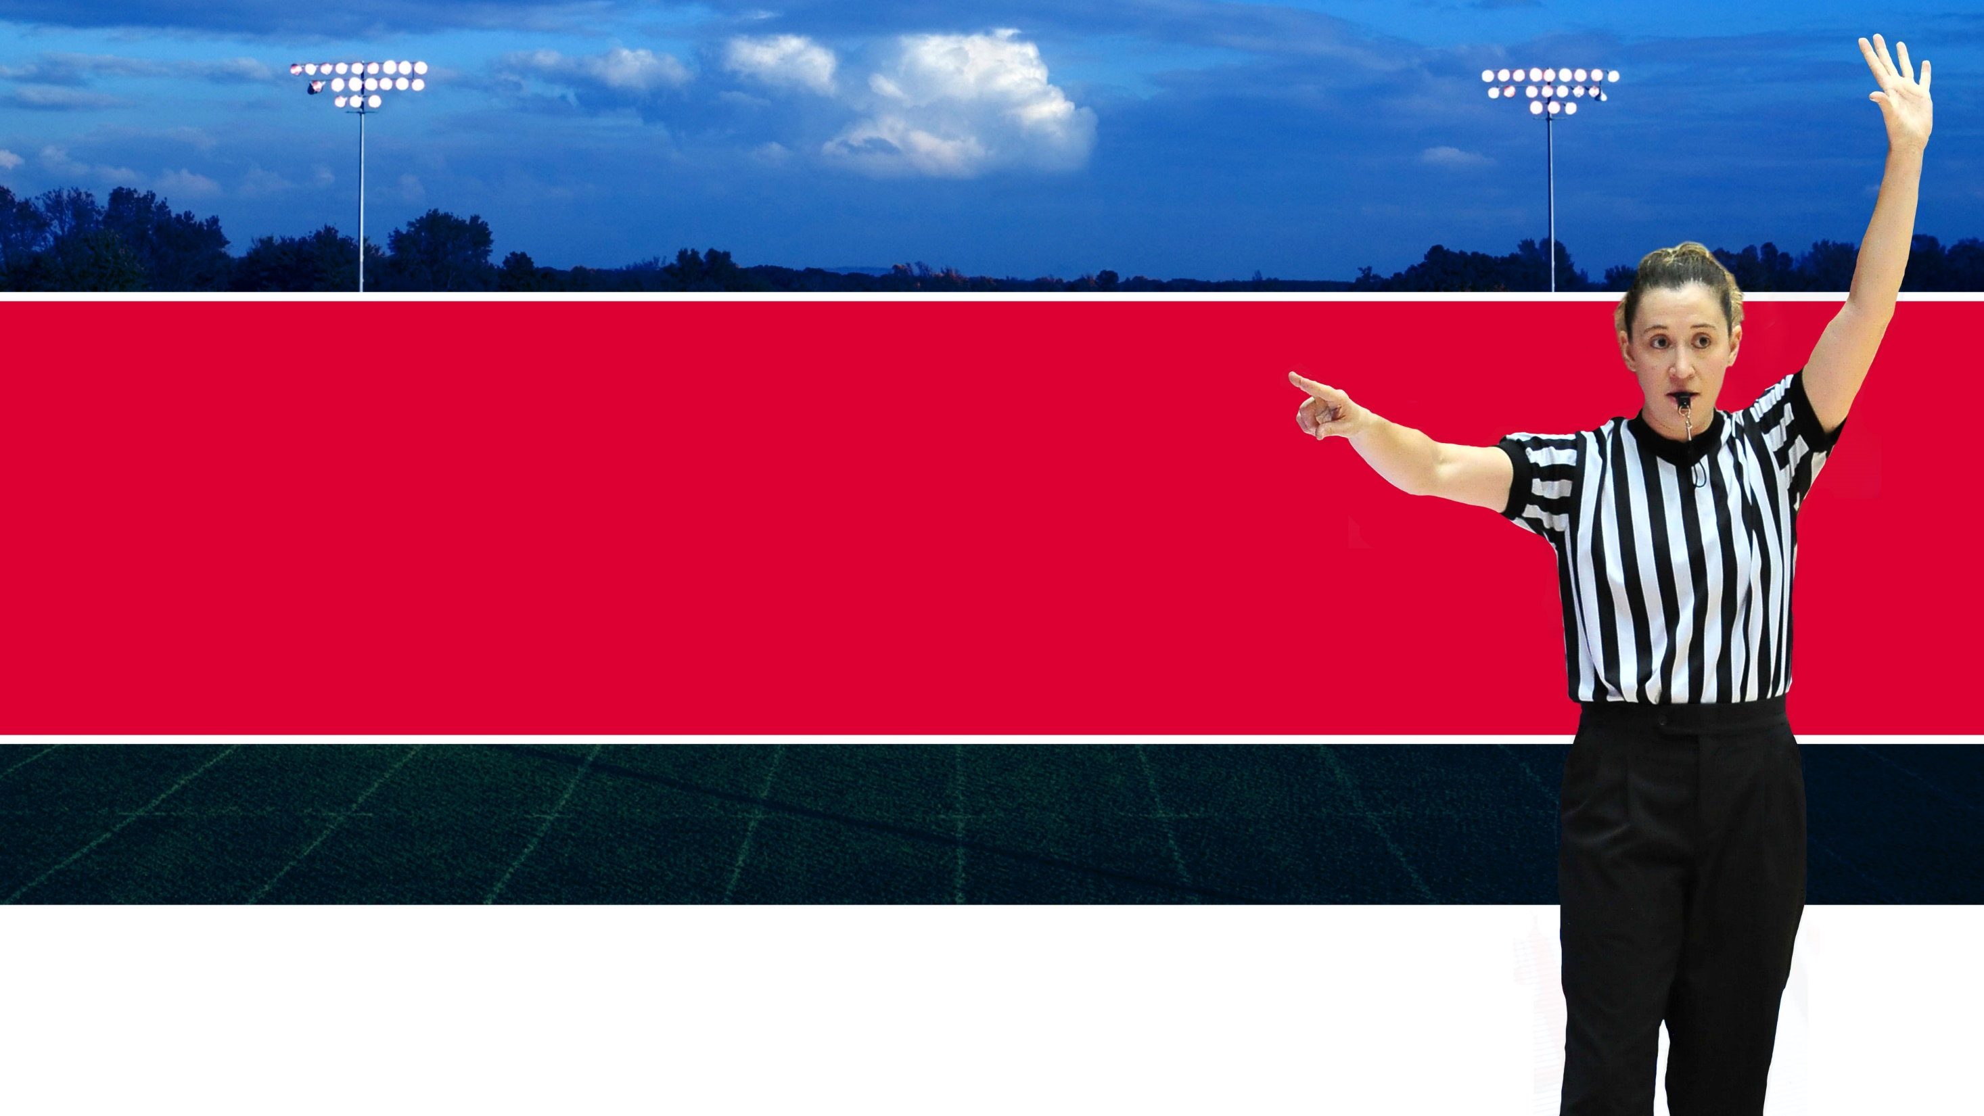




OFFICIALS EDUCATION
Content remains free of charge
TEACHING
AIDS
RULES
CHANGES
DIAGRAMS
VIDEO
LIBRARY
OFFICIALS
COURSES
Notes:
Sport-Specific Officiating courses are offered in several sports. They are ideal for new officials and those in the first few years of officiating. These courses introduce officials to the mechanics and techniques used in the sport and provide specific information on an area within that sport. Individuals can complete a course within 30-45 minutes. These courses are free to all officials and prospective officials.
“Interscholastic Officiating” is a general course on sports officiating, and it is free to all officials and prospective officials. This course provides an introduction to skills and concepts used as an official. Several topics are covered such as: basics of becoming and staying an official, science of officiating, art of officiating, how to combine these skills for successful officiating.
Video clips are made available to NFHS Officials Association members. The video is clipped on specific topics and provides the rules references as well as dialogue on the topic.
The courses and videos are offered at www.NFHSLearn.com .
*Courses Available:
Officiating Football
Officiating Volleyball – Ball Handling
Officiating Volleyball – Alignment
Officiating Volleyball – E-Whistle
Officiating Basketball
Officiating Basketball – Three-Person Mechanics
Officiating Basketball - Pre-Game Conference
Soccer – Fouls and Misconduct
Soccer – Offside
Soccer - Pre-Game Conference
Swimming and Diving
Officiating Wrestling
Umpiring Softball
Officiating Field Hockey
Officiating Track and Field
*Future Courses to be Considered:
Umpiring Baseball
Umpiring Softball – 2 Person Mechanics
Communication Among Officials and Coaches

Slide 52


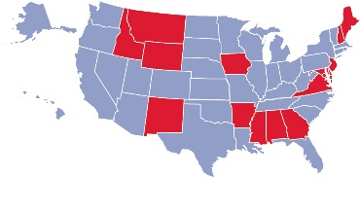
Future Developments:
Auto Assign
Mobil Assign
Customized Game and Travel Fees
Mass Update Capabilities
Integrated Playoff Financial Reporting
Improvements:
Invoicing
Updated Financial Reporting
Playoff and Tournament Bracketing
Eligibility Tracking Notifications
NFHS Learn Integration
Coming Fall 2023:
NFHS Exam Center
New Team App
New Form Builder
Year Three Accomplishments
16
194,810
$29M
States
Registering
Officials
Contests
Assigned
Payments
Sent to
Officials
100% FREE to your state as a NFHS-Member Benefit.
Notes:
NFHS CENTER FOR OFFICIALS SERVICES (COS)
Your Complete Solution for Officials Management and More:
Registration
Assignment
Payment
Testing
Background Checks
For More Information on the NFHS – Center for Officials Services (COS) Contact:
Dana Pappas, Director of Officiating Services, dpappas@nfhs.org
Also If You’re Interested in Eligibility and Monitoring Requirements Contact
the Folks at Dragonfly:
Kirk Miller, Dragonfly, kirk@dragonflyathletics.com
Brandon Wallace, Dragonfly, brandon@dragonflyathletics.com

Slide 53
NFHS Learning Center

Slide 54

Notes:
Comment on Slide:
The NFHS Learning Center is the home to more than 90 online professional development courses for everyone within the interscholastic community - coaches, students, officials, parents, administrators, and individuals within performing arts programs. More than 60 courses are available for free.
The NFHS is an Accredited Institution and has delivered more than 15 million courses on its NFHS Learning Center platform since its inception in 2007. In receiving national accreditation by Cognia, the NFHS has upheld itself to rigorous standards that focus on productive learning environments, equitable resource allocation that meet the needs of learners, and effective leadership.
The NFHS Learning Center features its flagship coaching course, “Fundamentals of Coaching,” as well as several health and safety courses that have been completed by millions of individuals, such as “Concussion in Sports,” “Heat Illness Prevention,” “Sudden Cardiac Arrest” and “Protecting Students from Abuse.” The NFHS Learning Center offers several national credentials that can be earned by individuals who complete specific NFHS courses. Through the School Honor Roll Program, schools can earn a physical banner to hang in their school.
To learn more and start your professional development journey, please visit the NFHS Learning Center at NFHSLearn.com.

Slide 55

NFHS Network

Slide 56
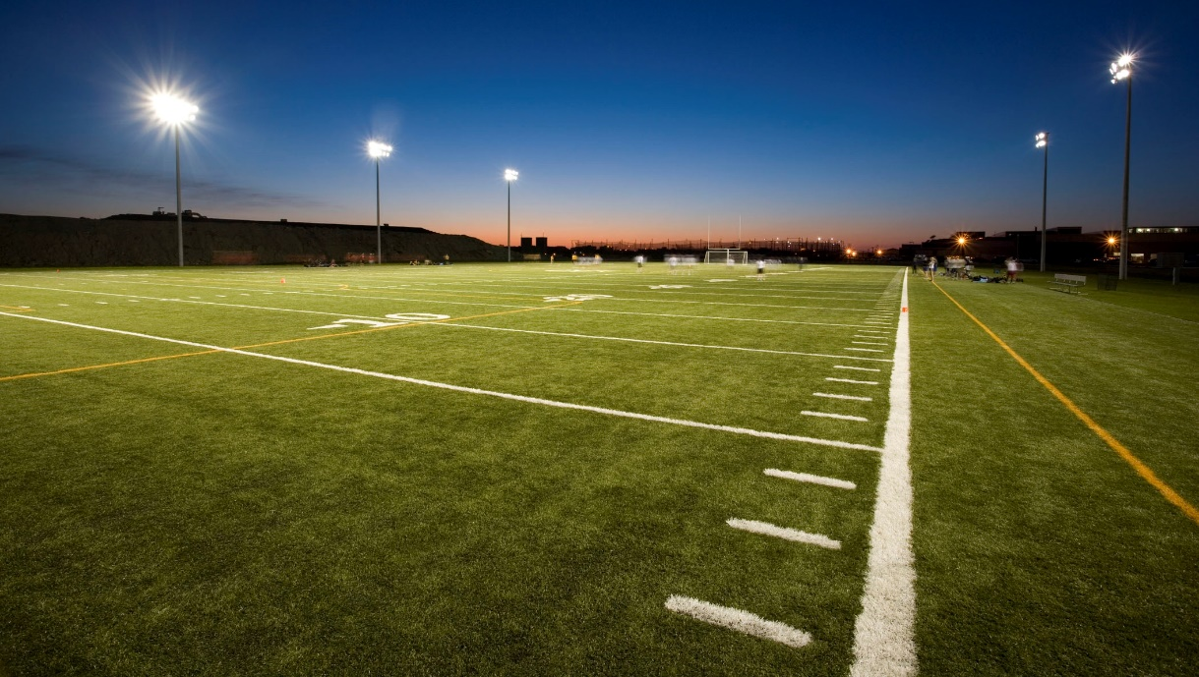
NFHS Network
By 2025, every high school sporting event in America will be streamed live.
The NFHS Network will be
THE DESTINATION for fans
to view these broadcasts.
27 Different Sports and Activities
www.NFHSnetwork.com
Notes:
Comment on Slide:
The NFHS Network is the leader in streaming Live and On Demand high school sports.
Partnered with the National Federation of State High School Associations, 45 high school state athletic/activities associations, and PlayOn! Sports, the NFHS Network is a joint venture created to provide fans with the ability to stream high school sports on any device, from wherever they are.
All NFHS Network events are available to watch online at www.NFHSnetwork.com and through the NFHS Network Live App for iOS and Android. Follow us on Facebook, Twitter, Instagram, and YouTube.
Watching high school sports and events has never been easier.
The NFHS Network’s goal to broadcast live all 2 million high school sporting events by 2025.
The NFHS Network covers 27 different regular season and postseason sports, as well as other high school activities, celebrating the accomplishments of students-athletes, student broadcasters, and high schools across the country.

Slide 57
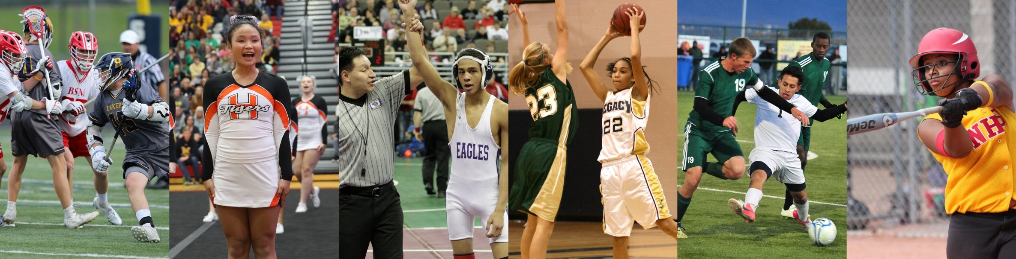
Thank You
National Federation of State High School Associations
PO Box 690 | Indianapolis, IN 46206
Phone: 317-972-6900 | Fax: 317.822.5700
www.nfhs.org | www.nfhslearn.com | www.nfhsnetwork.com

